Slide 1
Policies Approved by the
ASHP House of Delegates
March 15-22, 2024

Slide 2
The House of Delegates
Ultimate authority over ASHP professional policies
One annual session consisting of 2 in-person meetings at the June House of Delegates and 3 virtual meetings (March, May, and November)
The House considers professional policy proposals that have been approved by the Board of Directors
Most of these professional policy proposals are contained in reports from ASHP councils but may come from other component bodies, delegates, or ASHP members

Slide 3
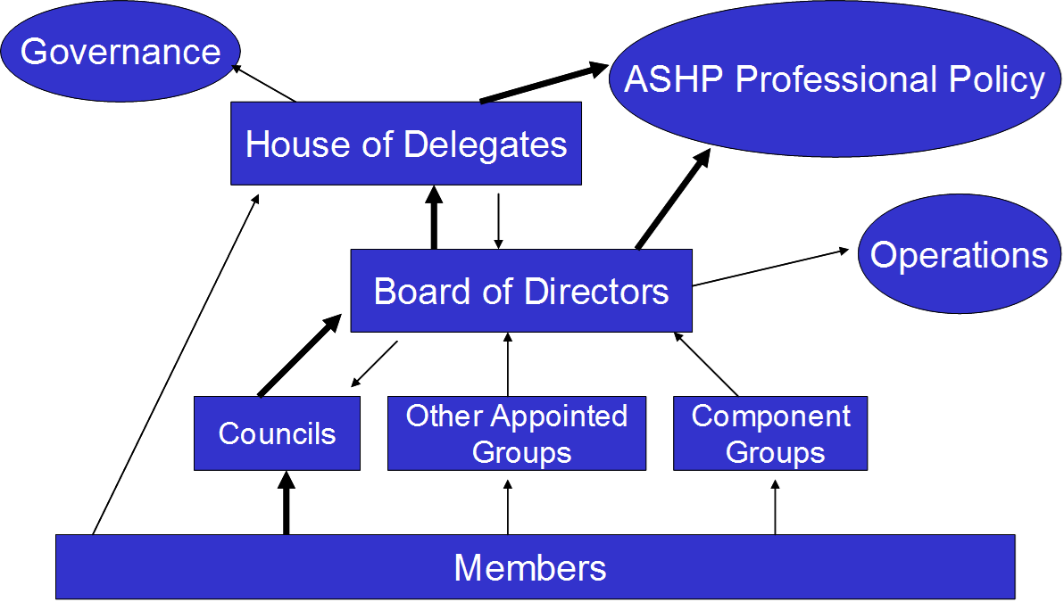
ASHP Policy Process

Slide 4
March 2024 Virtual House of Delegates
Between March 15 and 22, the House of Delegates voted on 20 policy recommendations.
The online voting process does not permit amendments.
Delegates are encouraged to vote against recommendations they feel should be amended.
>85% votes needed for approval
Policies not reaching that level of consensus will be considered by the House of Delegates in June

Slide 5
Results of March 2024 virtual House of Delegates
Delegates approved the following 12 recommendations by 85% or more, the threshold for final approval.
Eight policy recommendations did not meet that threshold and will be slated for consideration at the June meeting of the House.

Slide 6
CPhP: Role of the Pharmacy Workforce in Improving Mental Health
To advocate for equitable and destigmatized access to mental healthcare services for all patients across their lifespan, including members of the healthcare workforce; further,
To affirm the essential role of pharmacists, as members of the interprofessional care team, in increasing patient access to mental healthcare services; further,
To urge all members of the pharmacy workforce to raise awareness of, screen for, triage, and provide education on mental health conditions; further,
To advocate for expansion of mental health-related comprehensive medication management services provided by pharmacists; further,
To advocate for adequate funding of mental health awareness programs and for funding that promotes equitable access to mental healthcare services.

Slide 7
CPhP: Suicide Awareness, Prevention, and Response
To support the goal of zero suicides; further,
To collaborate with key stakeholders in support of suicide awareness, prevention, and response; further,
To acknowledge that optimal suicide awareness, prevention, and response efforts focus both on patients and on the healthcare workforce; further,
To recognize that pharmacists, as key members of the interprofessional care team, are integral to suicide awareness, prevention, and response efforts, and to acknowledge the vital role of other members of the pharmacy workforce in those efforts; further,
To foster the use and development of clinically validated tools to aid the pharmacy workforce in assessing the influence of medications and other factors on suicidality; further,
To advocate for adequate government and healthcare organization funding for suicide awareness, prevention, and response; further,
To enhance awareness of local, state, national, and global suicide awareness, prevention, and response resources.
Note: This policy supersedes ASHP policy 1901.

Slide 8
CPuP: Emergency Supplies of Drug Products
To discontinue ASHP policy 1906, Emergency Supplies of Drug Products, which reads:
To advocate for states to allow any pharmacist, during a declared emergency, to dispense without a prescription an emergency supply of a drug product in quantities that meet the needs of patients.

Slide 9
CPuP: Drug Nomenclature
To discontinue ASHP policy 9011, Drug Nomenclature, which reads:
To work with the FDA, USP, and pharmaceutical industry to assure that drug products are named in a manner that clearly and without confusion permits identification of ingredients’ strengths and changes.

Slide 10
COT: Medication Stewardship Programs
To advocate that pharmacists are foundational members of any medication stewardship program; further,
To affirm that pharmacists bring unique clinical, operational, safety, and financial expertise to help organizations develop and manage medication stewardship programs; further,
To promote pharmacist leadership in medication stewardship teams; further,
To encourage healthcare organizations to develop comprehensive medication stewardship programs that align with applicable laws, regulations, and accreditation standards; further,
To support incorporation and development of the pharmacy workforce in medication stewardship efforts; further,
To enhance awareness that medication stewardship includes disease state management across all levels of care and addresses barriers at the patient and system levels in order to improve the quality, safety, and value of patient care.

Slide 11
COT: Research on Drug Use in Obese Patients
To discontinue ASHP policy position 1920, Research on Drug Use in Obese Patients, which reads:
To encourage drug product manufacturers to conduct and publish pharmacokinetic and pharmacodynamic research in obese patients to facilitate safe and effective dosing of medications in this patient population, especially for medications most likely to be affected by obesity; further,
To encourage manufacturers to include in the Food and Drug Administration (FDA)–approved labeling detailed information on characteristics of individuals enrolled in drug dosing studies; further,
To advocate that the FDA develop guidance for the design and reporting of studies that support dosing recommendations in obese patients; further,
To advocate for increased enrollment and outcomes reporting of obese patients in clinical trials of medications; further,
To encourage independent research on the clinical significance of obesity on drug use, as well as the reporting and dissemination of this information via published literature, patient registries, and other mechanisms; further,
To recognize that pharmacists are medication therapy experts who should provide guidance on appropriate drug dosing for obese patients.

Slide 12
COT: Therapeutic Interchange
To discontinue ASHP policy 8708, Therapeutic Interchange, which reads:
To support the concept of therapeutic interchange of various drug products by pharmacists under arrangements where pharmacists and authorized prescribers interrelate on the behalf of patient care.

Slide 13
CEWD: Flexible Workforce Models
To advocate for flexible workforce models that promote patient safety and continuity of care, optimize pharmacy operations, and enhance recruitment and retention of the pharmacy workforce.

Slide 14
CPM: Pharmacist Access to Provider Networks
To advocate for laws and regulations that require healthcare payers to include pharmacists in their provider networks as standard coverage when providing patient care services within their scope of practice and the services are covered benefits; further,
To advocate that payers provide comparative, transparent sharing of performance and quality measure data for all providers in their networks, including pharmacists.
Note: This policy would supersede ASHP policy 2134.

Slide 15
CPM: Risk Assessment of Health Information Technology
To urge hospitals and health systems to directly involve departments of pharmacy in performing appropriate risk assessment before new health information technology (HIT) is implemented or existing HIT is upgraded, and as part of the continuous evaluation of current HIT performance; further,
To advocate that HIT vendors provide estimates of the resources required to implement and support new HIT; further,
To collaborate with HIT vendors to encourage the development of HIT that improves patient-care outcomes and user experience; further,
To advocate for changes in federal law that would recognize HIT vendors’ safety accountability.
Note: This policy would supersede ASHP policy 1418.

Slide 16
CPM: Unit Dose Packaging Availability
To advocate that pharmaceutical manufacturers provide all medications used in health systems in unit dose packages or, when applicable, in packaging that optimizes medication safety, improves operational efficiency, and reduces medication waste; further,
To urge that the Food and Drug Administration require pharmaceutical manufacturers to provide stability data to support the repackaging of medications outside of their original manufacturer bulk containers in the interest of public health, healthcare worker and patient safety, and reduced waste.
Note: This policy would supersede ASHP policy 2253.

Slide 17
CPM: Optimizing the Medication-Use Process
To discontinue ASHP policy 9903, Optimizing the Medication-Use Process, which reads:
To urge health-system pharmacists to assume leadership, responsibility, and accountability for the quality, effectiveness, and efficiency of the entire medication-use process (including prescribing, dispensing, administration, monitoring, and education) across the continuum of care; further,
To urge health-system pharmacists to work in collaboration with patients, prescribers, nurses, and other health care providers in improving the medication-use process.

