Slide 1
Policy Recommendations for the March Virtual ASHP House of Delegates
January 2025

Slide 2
The ASHP House of Delegates
Ultimate authority over ASHP professional policies
One annual session consisting of 2 in-person meetings at the June House of Delegates and 3 virtual meetings (March, May, and November)
The House considers professional policy proposals that have been approved by the Board of Directors
Most of these professional policy proposals are contained in reports from ASHP councils but may come from other component bodies, delegates, or ASHP members

Slide 3
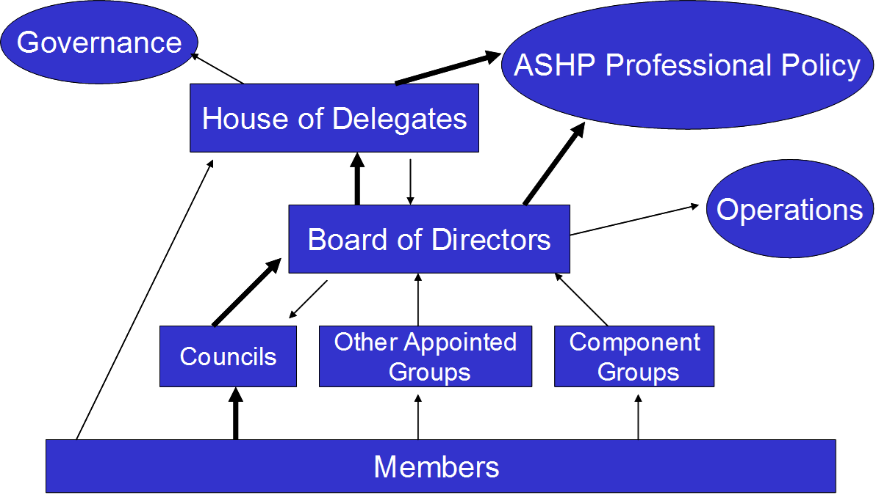
ASHP Policy Process

Slide 4
March Virtual House of Delegates
The policy recommendations in the following slides are scheduled to be considered at the March virtual House of Delegates.
If any of those policy recommendations are not approved, they will be considered at the June House of Delegates.
Proposed policies are found on the House of Delegates website and are debated on the ASHP House of Delegates Connect community by delegates and other ASHP members. It is important to review the Board Reports on Policy Recommendations for each meeting (found on the House of Delegates website) because that report provides a rationale and background information not found on ASHP Connect.
All ASHP members, including delegates, are encouraged to use the ASHP House of Delegates Connect community to review and comment on any of the proposed policies. Web-based discussion in advance of a House meeting may influence how delegates vote, and it also permits delegates to discuss potential amendments before the June House.

Slide 5
CEWD: Professional Development as a Retention Tool (March)
To recognize that pharmacy workforce development is an essential component of staff recruitment, retention, and well-being; further,
To recognize that pharmacy workforce development encompasses more than formal education programs and includes informal learning among colleagues, mentoring, participation in activities of professional organizations, and other types of learning; further,
To encourage healthcare executives to support pharmacy workforce development programs, including leadership succession planning, as an important benefit that aids in recruiting and retaining qualified staff; further,
To support healthcare executives with pharmacy workforce development by providing educational programs, services, and resources.
To encourage organizations to assess the effectiveness of professional development initiatives by evaluating their impact on recruitment and retention outcomes.
Note: This policy would supersede ASHP policy 2103.

Slide 6
CPM: Recovery and Assistance Programs for Healthcare Workers with Substance Use Disorder (March)
To advocate that hospitals and health systems establish recovery and assistance programs for healthcare workers with substance use disorders, including those who have diverted controlled substances to support their own drug addiction; further,
To encourage state licensing boards to support structured rehabilitation programs that demonstrate a clear pathway for recovery and return to practice upon successful completion of the program.

Slide 7
CPM: Pharmacy Access to Payer Networks (March)
To oppose pharmacy access criteria that impose discriminatory requirements or qualifications on participation in insurance payer networks that interfere with patient continuity of care or patient site-of-care options; further,
To advocate for laws and regulations that require healthcare payers to disclose to pharmacies applying to participate in payer networks the criteria and the clinical and operational outcome data reporting requirements used to include, retain, or exclude pharmacies; further,
To encourage healthcare payers to standardize network access criteria and eliminate those reporting requirements already imposed by accrediting bodies or regulatory agencies.
Note: This policy would supersede ASHP policy 2031.

Slide 8
CPhP: Safe and Secure Transfer of Controlled Substances (March)
To advocate for the standardization of policies, procedures, and practices in the handling of controlled substance medications throughout the care process, including transfers between emergency medical services and during interfacility transport; further,
To promote closed-loop communication processes related to controlled substance medication management during patient transfers; further,
To collaborate with emergency medical services and other stakeholders involved in pre- and post-hospital and interfacility transfers of controlled substances to improve patient safety, minimize variation, and ensure compliance.

Slide 9
CPhP: Pharmacy Services to Optimize Patient Throughput (March)
To support the integration of pharmacy services as systems are optimized to improve health system-wide patient throughput; further,
To advocate for pharmacists to serve as key decision-makers for improving patient flow throughout the health system; further,
To develop resources related to incorporating pharmacy services into patient throughput action plans and process maps; further,
To identify measures and tracking systems that demonstrate the impact of pharmacy-driven services to optimize patient throughput.

Slide 10
CPuP: Funding, Expertise, and Oversight of State Boards of Pharmacy (March)
To advocate appropriate oversight of pharmacy practice and the pharmaceutical supply chain through coordination and cooperation of state boards of pharmacy and other state and federal agencies whose mission it is to protect the public health; further,
To advocate representation on state boards of pharmacy and related agencies by pharmacists and pharmacy technicians; further,
To advocate that hospitals and health systems are adequately represented on state boards of pharmacy; further,
To advocate for dedicated funds for the exclusive use by state boards of pharmacy and related agencies to carry out expected duties; further,
To advocate for established training of state board of pharmacy inspectors in diverse pharmacy practice areas and the implementation of adequate inspection schedules to ensure the effective oversight and regulation of pharmacy practice, the integrity of the pharmaceutical supply chain, the protection of the public, and to establish variances from any documented rule by the board of pharmacy; further,
To advocate that inspections be performed only by individuals with demonstrated competency in the applicable area of practice.
Note: This policy would supersede ASHP policy 2021.

Slide 11
CPuP: Pharmacists Cross-State Licensure (March)
To advocate that state boards of pharmacy collaborate to streamline the licensure process through standardization and improve the timeliness of application approval across state lines; further,
To advocate that state boards of pharmacy collaborate with third-party vendors to streamline the licensure transfer or reciprocity process; further,
To advocate that boards of pharmacy grant licensed pharmacists in good standing temporary licensure, permitting them to engage in practice, while their application for licensure transfer or reciprocity is being processed.
Note: This policy would supersede ASHP policy 1621.

Slide 12
CPuP: Care-Commensurate Reimbursement (Discontinuation) (March)
To discontinue ASHP policy 2020, Care-Commensurate Reimbursement, which reads:
To advocate that reimbursement for healthcare services be commensurate with the level of care provided, based on the needs of the patient.

Slide 13
CPuP: Patient Adherence Programs as Part of Health Insurance Coverage (Discontinuation) (March)
To discontinue policy 1504, Patient Adherence Programs as Part of Health Insurance Coverage, which reads:
To advocate for the pharmacist's role in patient medication adherence programs that are part of health insurance plans; further,
To advocate those programs that (1) maintain the direct patient pharmacist relationship; (2) are based on the pharmacist's knowledge of the patient's medical history, indication for the prescribed medication, and expected therapeutic outcome; (3) use a communication method desired by the patient; (4) are consistent with federal and state regulations for patient confidentiality; and (5) permit dispensing of partial fills or overfills of prescription medications in order to synchronize medication refills and aid in medication adherence.

Slide 14
CPuP: Nonproprietary Naming of Biological Products (Discontinuation) (March)
To discontinue policy 1535, Nonproprietary Naming of Biologic Products, which reads:
To advocate that originator biological products, related biological products, and biosimilar products share the same global nonproprietary name as defined by the United States Adopted Name Council, the World Health Organization Programme on International Nonproprietary Names, and United States Pharmacopeial Convention; further,
To oppose unique nonproprietary naming for originator biological products, related biological products, and biosimilar products.

Slide 15
CPuP: Employee Testing (Discontinuation) (March)
To discontinue policy 9108, Employee Testing, which reads:
To oppose the use of truth-verification testing such as polygraphs as routine employment practices because of the possible interference with the rights of individuals; further,
To recognize the limited use of such testing during employment where such testing may protect the rights of individuals against false witness.

Slide 16
COT: Clinical and Safety Considerations of Naming Drug Moieties and Complexes (March)
To oppose the consolidation of existing drug classes that include drugs that have distinct pharmacologic effects and pharmacokinetic/pharmacodynamic profiles; further,
To encourage regulatory agencies to consider clinical, operational, access, and safety factors when approving and classifying medications with different moieties or complexes that are used to deliver the active drug; further,
To advocate for the pharmacist’s active role in these processes; further,
to foster increased pharmacist, provider, and public awareness when changes in approved drug products with therapeutic equivalence occur.

Slide 17
COT: Clinical, Operational, and Safe Use of Manipulated Drug Products and Alternate Administration Routes (March)
To support clinically appropriate, evidence-based use of manipulated drug-products or alternate drug administration routes when it supports optimal patient care; further,
To promote research that further delineates the pharmacokinetic and pharmacodynamic properties of drugs when manipulated or when given through alternate administration routes and investigate the interrelationship between drug exposure and safety and efficacy outcomes including the potential role of artificial intelligence in advancing model development and validation; further,
To encourage manufacturers to develop drug products in ready-to-use devices and diverse formulations; further,
To foster pharmacist-led interdisciplinary teams to provide institutional guidance, best practices, and safety recommendations regarding drug products that are manipulated or administered through alternative routes.
Note: This policy would supersede ASHP policies 2041, 2242, and 2314.

Slide 18
COT: Expedited Partner Directed Therapy (March)
To affirm that the pharmacy workforce improves patient access to therapies that prevent and treat sexually transmitted infections in all settings; further,
To support legislation that promotes expedited partner therapy (EPT); further,
To affirm that interpreting test results, prescribing, dosing, and dispensing therapies as clinically indicated is within pharmacists’ scope of practice; further,
To affirm that drug products for EPT should be provided to individuals in a manner that ensures safe and appropriate use; further,
To encourage surveillance of EPT as a public health effort.

Slide 19
COT: Generic Substitution of Narrow Therapeutic Index Drugs (Discontinuation) (March)
To discontinue ASHP policy 0817, Generic Substitution of Narrow Therapeutic Index Drugs, which reads:
To support the current processes used by the Food and Drug Administration (FDA) to determine bioequivalence of generic drug products, including those with a narrow therapeutic index, and to recognize the authority of the FDA to decide if additional studies are necessary to determine equivalence; further,
To oppose a blanket restriction on generic substitution for any medication or medication class without evidence from well-designed, independent studies that demonstrate inferior efficacy or safety of the generic drug product.

Slide 20
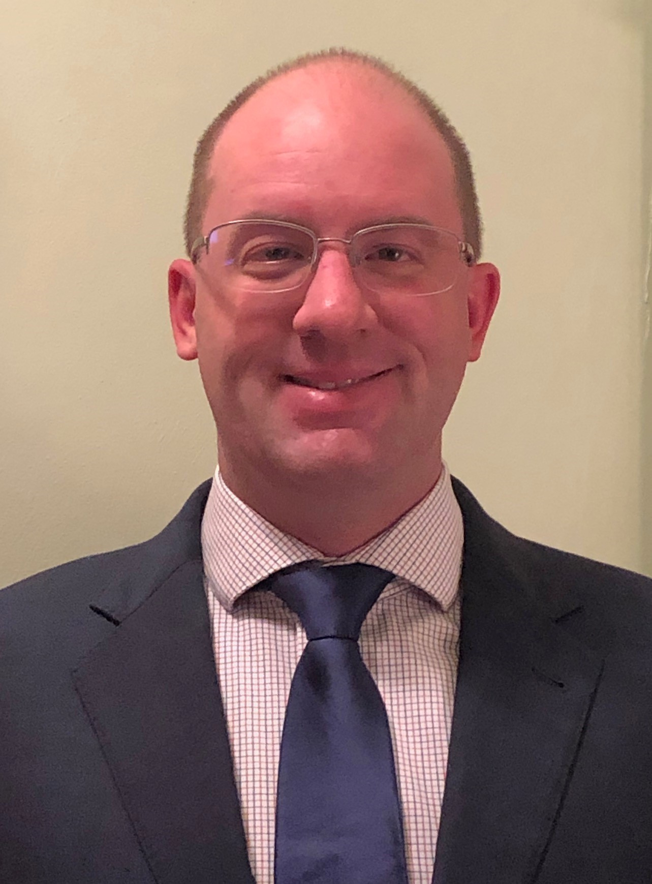
Questions or Suggestions?
Feel free to contact:
Jesse Hogue, Chair, ASHP House of Delegates:
hodchair@ashp.org
ASHP policy website: https://www.ashp.org/Pharmacy-Practice/Policy-Positions-and-Guidelines/

