Slide 1
Policies Approved by the May/June ASHP House of Delegates

Slide 2
The House of Delegates
Ultimate authority over ASHP professional policies
One annual session consisting of 2 in-person meetings at the June House of Delegates and 3 virtual meetings (March, May, and November)
The House considers professional policy proposals that have been approved by the Board of Directors
Most of these professional policy proposals are contained in reports from ASHP councils but may come from other component bodies, delegates, or ASHP members

Slide 3
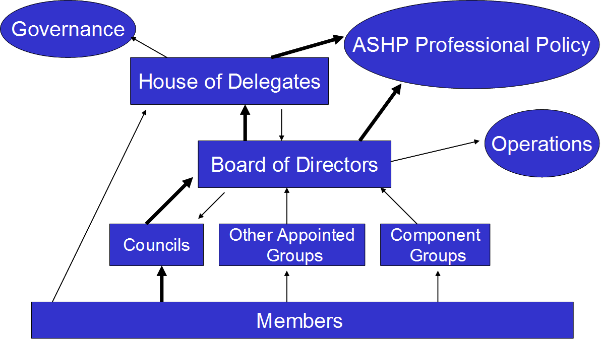
ASHP Policy Process

Slide 4
May and June House of Delegates Meetings
The policy recommendations in the following slides were approved at the May virtual House and the June meetings of the House of Delegates.

Slide 5
CPM: Supporting High Reliability in Pharmacy Practice (May)
To state that a commitment to the principles and science of high reliability, with the goals of zero medication errors and zero harm, are foundational to pharmacy excellence; further,
To encourage hospitals and health systems to commit to high-reliability principles; further,
To encourage research that informs the creation of best practices in high reliability and progress toward implementation of high-reliability principles in all pharmacy services.

Slide 6
SCCP: ASHP Statement on the Community Pharmacist’s Role in the Care Continuum (May)
To approve the ASHP Statement on the Community Pharmacist’s Role in the Care Continuum.

Slide 7
COT: 5-HT₂ Agonist, Entactogen, and Empathogen (Psychedelic) Assisted Therapy (June)
To recognize that psychedelic-assisted therapy (PAT) has demonstrated therapeutic potential and should be further researched; further,
To recognize that in PAT there is not a standardized product subject to the same regulations as a prescription drug product, and to support the development of standardized formulations of psychedelics that would provide consistent potency and quality; further,
To encourage state boards of pharmacy, regulatory agencies, and safety bodies with an interest in PAT to promote research best practices and regulatory standards for medication preparation, compounding, and administration to ensure safety and quality; further,
To advocate that when psychedelics are used for PAT, healthcare providers, including pharmacists, should assess patients for medical, pharmacologic, and psychosocial contraindications prior to use and provide medical assistance as needed.

Slide 8
CEWD: Pharmacy Residency Training (June)
To continue efforts to increase the number of ASHP-accredited pharmacy residency training programs and positions available; further,
To promote efforts to increase recruitment and retention of residents in ASHP-accredited pharmacy residency programs; further,
To encourage stakeholders to evaluate priority areas within pharmacy for future residency training needs.
Note: This policy supersedes ASHP policy 0917.

Slide 9
CPhP: Prehospital Management of Medications (June)
To assert that variation in the prehospital management and use of medications is a risk to patient safety and continuity of care; further,
To advocate for pharmacy workforce involvement in clinical and operational decision-making for prehospital management and utilization of medications; further,
To collaborate with stakeholders involved in prehospital medication-use decisions to improve patient safety, minimize variation, and reduce inefficiencies.

Slide 10
CPhP: Role of Artificial Intelligence in Pharmacy Practice (June)
To embrace artificial intelligence (AI) as a tool with tremendous potential to improve patient care and the medication-use process through the enhancement of pharmacy practice; further,
To recognize that AI technologies offer innovative ways to gather clinical knowledge, assist learners, enhance educational experiences, and streamline administrative processes; further,
To advocate for standards, policies, and procedures that permit the use of AI in circumstances in which it has proven safe and effective as an augmentation of pharmacy services and to ensure safeguards along with its implementation; further,

Slide 11
CPhP: Role of Artificial Intelligence in Pharmacy Practice (cont’d) (June)
To encourage the adoption of policies regarding the use of AI and ongoing surveillance of these tools to maintain professional integrity; further,
To advocate for pharmacy workforce involvement and transparency in the decision-making, design, validation, implementation, and ongoing evaluation of AI-related applications and technologies; further,
To recognize that ethical considerations must guide the development and use of AI in pharmacy practice, and to oppose any use of AI that compromises human interaction or replaces ethical decision-making, professional judgment, critical thinking, or the safety and effectiveness of pharmacy services.

Slide 12
CPhP: Pharmacist’s Role on Ethics Committees (June)
To advocate that pharmacists should be included as members of hospital and health-system ethics committees; further,
To encourage pharmacists to actively seek ethics consultations as appropriate; further,
To support continued inclusion of ethics in pharmacy education and encourage pharmacists serving on ethics committees to seek advanced training in healthcare ethics.
Note: This policy supersedes ASHP policy 1403.

Slide 13
CPhP: Enhancing the Safety of Hazardous Drug Product Handling (June)
To advocate that pharmaceutical manufacturers and wholesale distributors employ decontamination practices to eliminate surface contamination on packages of hazardous drugs (HDs); further,
To advocate that pharmaceutical manufacturers develop closed-system transfer device compatible, ready-to-administer HD products; further,
To advocate for standardized labeling and package design for HDs that would alert handlers to the potential presence of surface contamination; further,
To advocate for pharmacist involvement in the development of policies, procedures, and operational assessments regarding administration of HDs.
Note: This policy supersedes ASHP policies 1615 and 1902.

Slide 14
CPuP: Independent Double Checks for Single Practitioners (June)
To advocate for implementation of independent double checks, when feasible, to reduce the risk of error when a single practitioner is solely responsible for ordering, dispensing, administering, and monitoring medication therapy.

Slide 15
CPuP: State Prescription Drug Monitoring Programs (June)
To support continued state implementation of prescription drug monitoring programs that collect real-time, relevant, and standard information from all dispensing outpatient entities about controlled substances and monitored prescriptions; further,
To advocate that such programs and states seek adoption into health information exchanges to best integrate into electronic health records and to allow prescribers, the pharmacy workforce, and other practitioners to proactively monitor data for appropriate assessment and dispensing; further,
To advocate that such programs improve their interstate data integration to enhance clinical decision-making and end-user satisfaction; further,

Slide 16
CPuP: State Prescription Drug Monitoring Programs (Cont’d) (June)
To advocate against unilateral use of these systems that may lead to patient stigmatization or prevent them from seeking appropriate medical care; further,
To encourage policies that allow the pharmacy workforce to gain access to databases without holding licensure in each state; further,
To promote research on the effects of prescription drug monitoring programs and electronic health record programs on prescribing, dispensing, misuse, morbidity, and mortality.
Note: This policy would supersede ASHP policy 1408.

Slide 17
COT: Testing for Pregnancy Status (June)
To affirm that pregnancy testing should occur only with the patient’s informed consent or assent, when feasible, and only when the test results would change medical management; further,
To affirm that a positive pregnancy test should not compromise the integrity of evidence-based, patient-centered care.

Slide 18
COT: Nonprescription Status of Rescue and Reversal Medications (June)
To support the nonprescription status of medications intended for evidence-based rescue use or reversal of potentially fatal events, in delivery systems appropriate for administration by lay persons; further,
To promote practices and policies that ensure affordable and equitable access to rescue and reversal medications; further,
To support and foster standardized education and training on the role of rescue and reversal medications and their proper storage, proper administration, safe use, and appropriate follow-up care.

Slide 19
CEWD: Opposition to Pharmacy Jurisprudence Examination Requirement (June)
To advocate for the removal of standalone examination of federal or state pharmacy law as a requirement for licensure to increase interstate practice flexibility; further,
To support ongoing education of the pharmacy workforce on pertinent federal and state pharmacy laws; further,
To acknowledge that it is a professional obligation of the pharmacy workforce to practice in compliance with federal and state laws.

Slide 20
CPM: Documentation of Patient-Care Services in the Permanent Health Record (June)
To advocate for public policies that support documentation of patient-care services provided by the pharmacy workforce in the permanent patient health record; further,
To advocate for the design and use of electronic health records with a common documentation space to accommodate all healthcare team members.
Note: This policy supersedes ASHP policy 1419.

Slide 21
CPM: Safe Medication Sourcing, Storage, Preparation, and Administration in All Sites of Care (June)
To advocate that all sites of care be required to meet the same regulatory standards for medication sourcing, storage, preparation, and administration to ensure safety and quality.
Note: This policy supersedes ASHP policy 1914.

Slide 22
CPhP: Independent Prescribing Authority (June)
To affirm that pharmacists are highly trained medication experts on the interprofessional care team who make evidence-based decisions; further,
To advocate that pharmacists have independent authority to initiate, monitor, modify, and deprescribe all schedules and classes of medications, commensurate with the pharmacist’s training and in accordance with the standard of care; further,
To encourage healthcare delivery organizations to establish credentialing and privileging processes for pharmacists that delineate scope of practice, support pharmacist prescribing, and ensure that pharmacists who prescribe are accountable, competent, and qualified to do so; further,
To advocate that pharmacists be recognized as authorized providers by payers, pharmacies, and industry.
Note: This policy supersedes ASHP policies 2236 and 2251.

Slide 23
CEWD: Additional Education Requirements for Pharmacy Technicians in Advanced Roles (June)
To recognize that highly trained and skilled pharmacy technicians working in advanced roles regularly perform complex and critical medication-use procedures, and that a safe and effective medication-use process depends significantly on the skills, knowledge, and competency of those pharmacy technicians to perform those tasks; further,
To reaffirm that all pharmacy technicians should complete an ASHP-accredited training program, be certified by the Pharmacy Technician Certification Board, and be licensed by state boards of pharmacy; further,
To advocate that beyond those requirements, pharmacy technicians working in advanced roles should complete at a minimum an associate of science degree and demonstrate ongoing competencies specific to the tasks to be performed; further,
To advocate that expansion of pharmacy technician duties into expanded, advanced roles should include consideration of potential risk to patients and that ongoing quality assurance metrics should be established to assure patient safety.
Note: This policy would supersede ASHP policy 1203.

Slide 24
CPuP: Liability Protection (June)
To advocate that the pharmacy workforce be able to provide services consistent with the standard of care to patients without fear of legal consequences, harassment, or liability; further,
To advocate that protection against liability extend to referrals for out-of-state care and for providing services consistent with the standard of care to patients from another state.

Slide 25
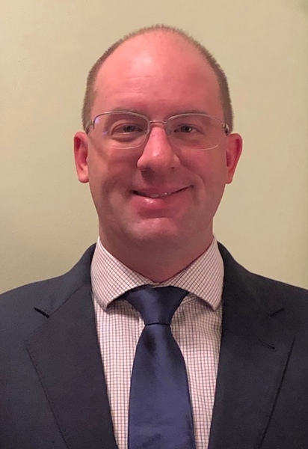
Questions or Suggestions?
Feel free to contact:
Jesse Hogue, Chair, ASHP House of Delegates:
hodchair@ashp.org
ASHP policy website: https://www.ashp.org/Pharmacy-Practice/Policy-Positions-and-Guidelines/

