Slide 1
ASHP Practice Advancement Initiative (PAI) 2030
<<INSERT ORGANIZATION OR STATE AFFILIATE NAME>>

Slide 2
Outline
Overview of PAI 2030
State of practice
Identifying opportunities
Engaging the team
Influencing change
How can ASHP help?

Slide 3
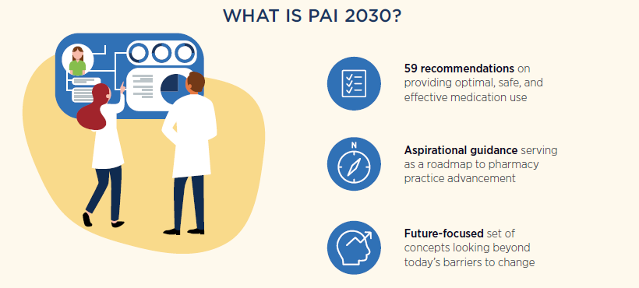
ASHP Practice Advancement Initiative 2030: New recommendations for advancing pharmacy practice in health systems. Amer J Health-Syst Pharm. 2020;77:113-121. https://doi.org/10.1093/ajhp/zxz271
Notes:
PAI 2030 includes 59 recommendations for providing optimal, safe, and effective medication use. They represent the aspirational guidelines for pharmacy practice advancement over this next decade. As such, they are very future-focused. These recommendations outline actions to anticipate future changes that will affect the pharmacy enterprise, and will help pharmacists, technicians, health systems, and pharmacy leaders plan for future changes. . The revised set of concepts are aspirational rather than prescriptive so practitioners can customize implementation plans for their institutional setting and revise as conditions evolve.

Slide 4
^{Patient-} ^{Centered Care} | ^{Pharmacist Role,} ^{Education,} ^{and Training} | ^{Technology} ^{and Data Science} | ^{Pharmacy Technician} ^{Role, Education,} ^{and Training} | ^{Leadership} ^{in Medication} ^{Use and Safety}
Shift from patient advocacy to patient and family activation Integrate pharmacy enterprise for convenient and cost-effective care Optimize care via pharmacist-provided comprehensive medication management | Increase in the credentialing and privileging of pharmacists in health systems ^{Proliferation of board} certification in many practice areas Building of workforce skills in population health management and mental/behavioral health | Harness data analytics to improve patient health Augmented intelligence is an important developing technology that will impact operations and practice Assessing patient care technologies to support optimal medication-use outcomes | Foster development of professional career paths for pharmacy technicians Achieve a recognized scope of practice Advance pharmacy technician roles to improve patient care access | Advance use of pharmacogenomics information and lead medication stewardship activities Increase public health opportunities to address social determinants, chronic illness, and addiction Support the well-being and resiliency of pharmacy workforce
The ASHP Practice Advancement Initiative (PAI) 2030 includes 59 recommendations to promote optimal, safe, and effective medication use; expand pharmacist and technician roles; and implement the latest technologies.
Learn more about PAI 2030 at ASHP.ORG/PAI
Notes:
The recommendations are divided into 5 domains. Let’s take a moment to go through the structure of the PAI and how it is working.
There are five domains. The first column is Patient-Centered Care. This area recognizes that we're going to see shifts from the patient advocacy to patient and family involvement. We're going to see integration of the pharmacy enterprise for convenient and cost effective care. Likewise, we're going to be optimizing care via pharmacist-provided comprehensive medication management.
The second column is the pharmacist’s role in education and training. This area highlights that there will be increased credentialing and privileging of pharmacists. By credentialing, what I mean is the degrees that you get, the certifications you get, the Board credentialing that you might do, and then privileging is within your own organization: are you allowed to have some of these advanced privileges, does the organization recognize you as competent to provide those. What this will also mean is there will be increased certification areas. There may be additional skills that you will want to show that you have emphasized that area, and you have taken the time to get certification in that area. We'll be developing new skills, particularly in the area of population health and in mental and behavioral health.
The third column is technology and data science. This domain has recommendations around the application of new technologies as well as how we harness all the data we have in order to ultimately improve care.
The fourth column is the pharmacy technician role, education, and training. It recognizes that there will be additional career paths for the pharmacy technician, and that we need to help technicians develop many advanced roles.
The fifth column is leadership in medication use and safety. Some of the items in this domain include using pharmacogenomic information in patient-care decisions, leading in medication stewardship, increased public health opportunities to address social determinants of care, chronic illness, and addiction and to support the workforce well-being and resiliency.

Slide 5
PAI 2030 Implementation Pathway
Practice Setting/ Organizational Readiness
Review Action List and Assign Feasibility & Impact
Complete reassessment PAI 2030 Self-Assessment Tool
Get Started & Build Your Team
Prepare to Launch
Assess Current Practice
Create an Action Plan
Improve Your Practice
Monitor Your Progress
Tell Your Story
Complete PAI 2030
Self-Assessment Tool
Organization
Practitioner
Personal vs. Official
Identify State Champion
Champion PAI 2030 orientation
PAI 2030 Self-Assessment Tool tutorial
Strategic Planning
Goals
Objectives
Develop specific plans of action
PAI 2030 Focused Initiatives
Case Studies, podcasts, webinars
Toolkits/playbooks
Publish articles
Inform professional policy
Advocacy agenda
Indicators of progress
Notes:
Building team (champion identification, orientation, tutorial)
Prepare to Launch (state affiliate marketing, communication campaign)
Assess Current Practice (completion of PAI 2030 Self-Assessment Tool)
Create an Action Plan (review assessment tool action list and assign feasibility and impact)
Take Steps to Improve Practice (goal and objective setting, develop plans of action, indicators of progress)
Monitor Progress (complete reassessments, sharing results, PAI 2030 Focused Initiative progress);
Tell the Story (e.g., case study, podcast, webinar, manuscript submission, playbook)

Slide 6
Current Trends in Pharmacy Practice
<<Consider including stats from ASHP National Surveys of Pharmacy Practice in Hospital Settings>>
<<State specific data/happenings>>

Slide 7
Identifying Opportunities

Slide 8
PAI 2030 Implementation Pathway
Identify
Building team (champion identification, orientation, tutorial)
Prepare to launch (state affiliate marketing, communication campaign)
Involve
Assess current practice (completion of PAI 2030 Self-Assessment Tool)
Create an action plan (assignment of feasibility and impact)
Take steps to improve practice (goal & objective setting, develop plans of action, indicators of progress)
Influence
Monitor progress (complete reassessments, sharing results, PAI 2030 focused initiative progress)
Tell the story (case study, podcast, webinar, manuscript submission, playbook)

Slide 9
PAI 2030 State Affiliate Champion Team
<<Introduce champion, leadership team, and/or task force etc.>>
<<Indicate and discuss initial goals/objectives established by PAII 2030 leadership team>>

Slide 10
PAI 2030 State Communication Plan
<<Highlight state affiliate marketing efforts supporting PAI 2030 adoption and implementation>>
<<Identify components of state PAI 2030 communication campaign>>

Slide 11
PAI 2030 Tools & Resources
www.ashp.org/pai
State Affiliate Toolkit and Champion Approach
PAI 2030 Self-Assessment Tool
Two tracks (Practitioner and Organization)
Identify gaps with the PAI 2030 recommendations
Create an action plan for adoption and implementation
Case Studies, Podcasts, Webinars
Testimonials on where pharmacy departments and pharmacists are making an impact implementing the PAI 2030 recommendations
Awards and Research
ASHP Best Practices Award
ASHP Student Leadership Award
ASHP Foundation Research Grants
Notes:
The PAI 2030 self-assessment tool can be used both as a practice individual level or an organizational level.
There are, case studies, podcasts, and webinars that are all resources available to you.
ASHP has developed a state affiliate toolkit that is available that provides tools and resources used at the state level, but you can also take a look at the resources to see how they might apply to you on an individual level.
What the materials have in mind is that there be a PAI 2030 champion (or task force or group) in your state, or for each state affiliate, that could work with people in the state to drive the change that the recommendations advocate for.
The toolkit has suggestions for step-by-step plans to guide your efforts. State toolkits are also designed to partner with students and residents, and there is also a student/SSHP resource page available. You can see we are trying to pull this through at all levels to provide the resources that you might need for implementation.
Likewise, we believe it is important to highlight the successes and wins that we have, so we have some best practice award programs that recognize some of the best efforts in moving these recommendations forward.

Slide 12
PAI 2030 State Affiliate Toolkit
Sample announcements
Sample leader team discussion and meeting agendas
PAI 2030 Self-Assessment Tool tutorial (recorded)
PAI 2030 champion overview presentation (recorded)
Prepared slide presentation template to personalize for each state
Sample communications template (email, newsletter, social)
Links to other relevant PAI materials (AJHP articles, podcasts)
SSHP PAI 2030 resource page
Notes:
1) This is what we have so far
2) How to use it
Train PAI champion to use a prepared slide deck that could be personalized for each state and in use of a State Affiliate Toolkit with step-by-step plans to guide continued efforts.
3) What else is needed?
NOTE: Need to strike a balance between not enough information and too much information. We want to provide enough information so the affiliate/members do not have to spend additional time researching an issue but don’t want to provide so much information the affiliate members become overwhelmed or lost.

Slide 13
Discussion Question <<EXAMPLE>>
What components of PAI 2030 resonate with you?

Slide 14
Engaging the Team

Slide 15
PAI 2030 Implementation Pathway
Identify
Building team (champion identification, orientation, tutorial)
Prepare to launch (state affiliate marketing, communication campaign)
Involve
Assess current practice (completion of PAI 2030 Self-Assessment Tool)
Create an action plan (assignment of feasibility and impact)
Take steps to improve practice (goal & objective setting, develop plans of action, indicators of progress)
Influence
Monitor progress (complete reassessments, sharing results, PAI 2030 focused initiative progress)
Tell the story (case study, podcast, webinar, manuscript submission, playbook)

Slide 16
Assessing Current Practice
Achieve statewide completion rate of ≥ XX% within XX months using the PAI 2030 Self-Assessment Tool
Focus on completion of “organization” self-assessment track
Complete one “official” self-assessment for each organization/practice site
Engage learners in process, partner with SSHPs
Self-assessment tutorial available on ASHP PAI 2030 State Affiliate Toolkit

Slide 17
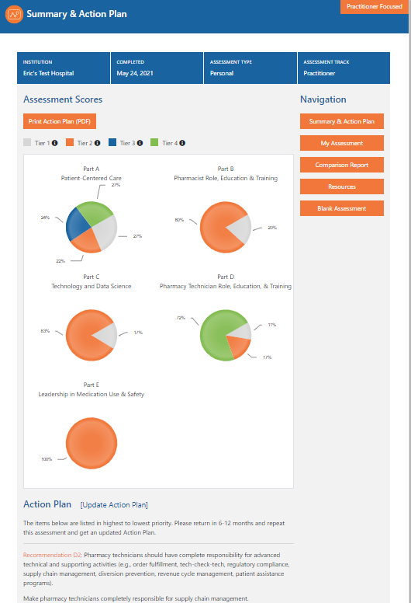
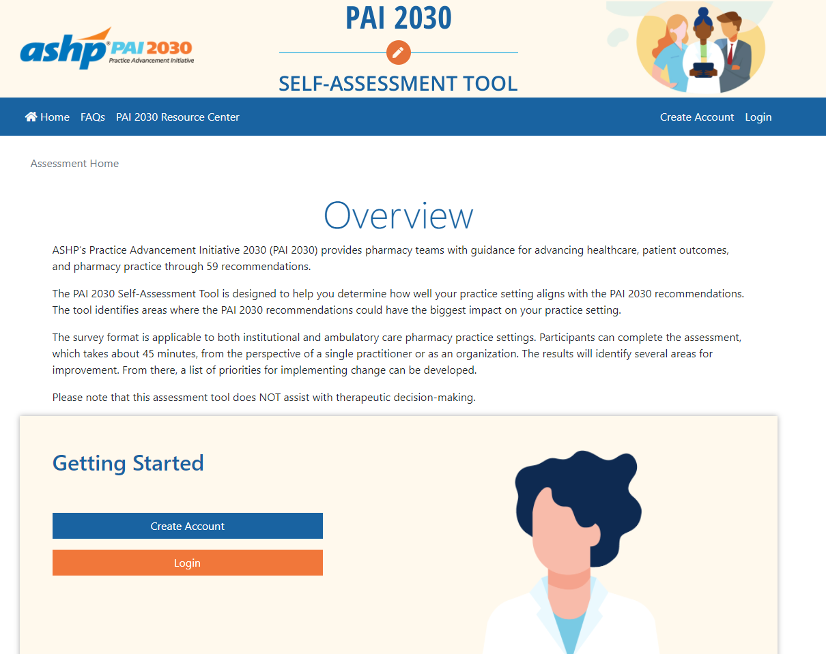
ACCESS TO SELF-ASSESSMENT TOOL:
https://pai2030tool.ashp.org/
PAI 2030 Self-Assessment Tool
Tiered Scoring by Domain & Action Plan
ASHP Podcast: Using the ASHP Practice Advancement Initiative (PAI) 2030 Self-Assessment Tool to Influence Practice Transformation
Notes:
The PAI 2030 Self-Assessment Tool is designed to help you determine how well your practice setting aligns with the PAI 2030 recommendations. The tool identifies areas where the PAI 2030 recommendations could have the biggest impact on your practice setting.
The survey format is applicable to both institutional and ambulatory care pharmacy practice settings. Participants can complete the assessment, which takes about 45 minutes, from the perspective of a single practitioner or as an organization. The results will identify several areas for improvement. From there, a list of priorities for implementing change can be developed.

Slide 18
Discussion Question <<EXAMPLE>>
How will the smaller hospitals approach to PAI 2030 differ from the way larger hospitals approach PAI 2030?

Slide 19
Create Statewide Action Plan
Review self-assessment “Action List”
Assign feasibility and impact for prioritization of “Action List” items to create “Action Plan”
Integrate “Action Plan” with statewide strategic plan
Helps inform state practice advancement goals & objectives
Informs state advocacy agenda
Forward thinking pays dividends

Slide 20
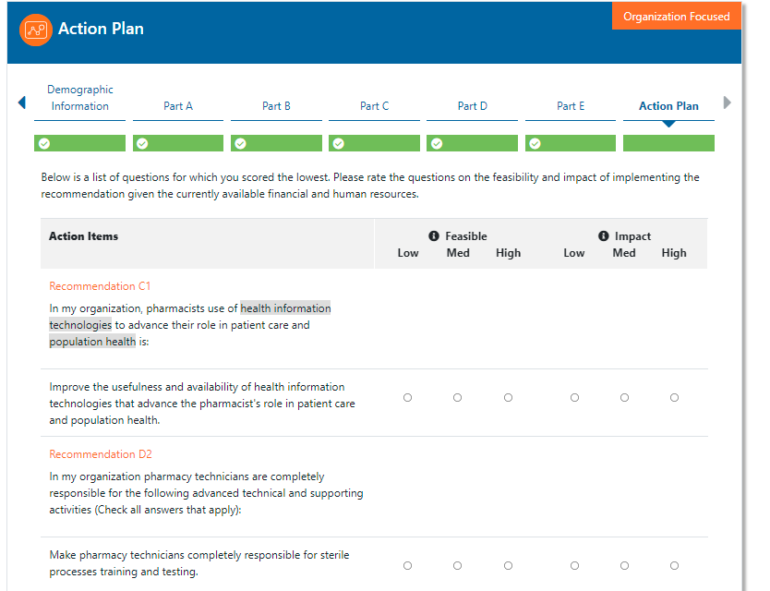
Action List
Assignment of feasibility and impact to lowest scoring items from self-assessment tool
Notes:
Top 15 of lowest scoring items to assign feasibility and impact

Slide 21
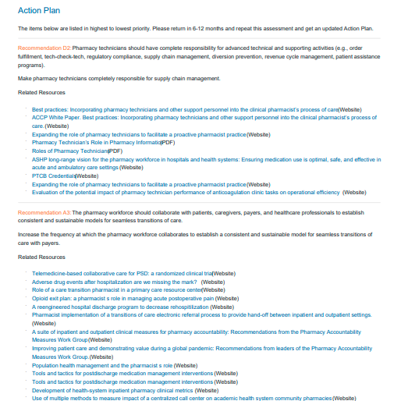
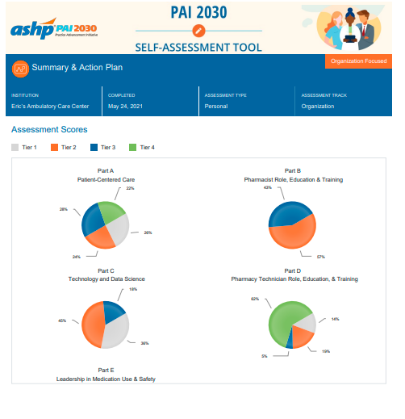
Action Plan
Notes:
Note: items that appear on Action Plans were first on an Action List because the answer to the question was low scoring. The items were then ranked based on the account holders perspective on the feasibility of addressing the item and the impact it will have on a practice setting/organization.

Slide 22
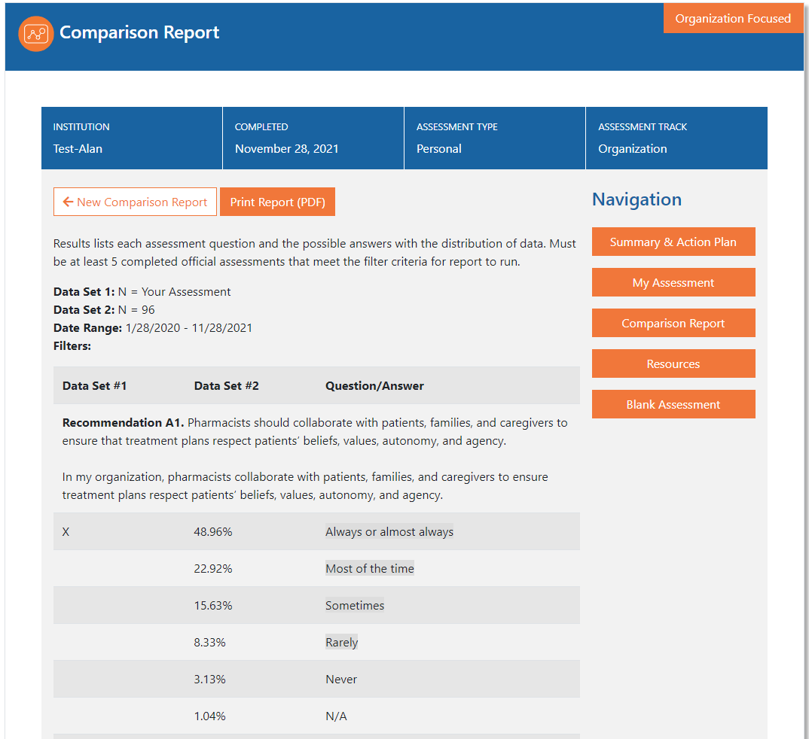
See Where You Stand
Use the comparison tool to compare your practice with others
Region
State
Facility bed size

Slide 23
Action Plan Trends Report (Organization - Official)
<<EXAMPLE TRENDS>>
Recommendation A2. Pharmacist interns and/or student pharmacists engage in medication reconciliation processes during care transitions: Discharged from an inpatient ward
Recommendation A2. Pharmacy workforce (pharmacists, pharmacy technicians) leads medication reconciliation processes during care transitions: Admitted to an inpatient ward
Recommendation A2. Pharmacy workforce (pharmacists, pharmacy technicians) leads medication reconciliation processes during care transitions: In the emergency department
Recommendation A4. Make documentation made by pharmacists related to patient care available to: Community pharmacies or other external pharmacy service providers
Recommendation D3. Increase the number of newly hired pharmacy technicians who have completed an ASHP/ACPE-accredited technician education and training program
Notes:
Report shows the 10 assessment questions that most frequently appeared on Action Plans of completed Official Assessments. Note: items that appear on Action Plans were first on an Action List because the answer to the question was low scoring. The items were then ranked based on the account holders perspective on the feasibility of address the item and the impact it would have on the Organization. (NOTE: Only first five depicted for illustrative purposes)

Slide 24
Comparative Report Results (Organization) <<EXAMPLE RESULTS>>
(A2) The pharmacy workforce in my organization leads and/or engages in medication reconciliation processes during care transitions:
In ambulatory care settings
 | 43.86% | Pharmacist/Pharmacy Technician
 | 15.79% | Intern or Student Pharmacist
 | 10.53% | Practice setting not available at my facility
 | 45.61% | The pharmacy workforce is NOT involved with the medication reconciliation processes in this area
In the emergency department
 | 70.18% | Pharmacist/Pharmacy Technician
 | 36.84% | Intern or Student Pharmacist
 | 1.75% | Practice setting not available at my facility
 | 28.07% | The pharmacy workforce is NOT involved with the medication reconciliation processes in this area
When admitted to an inpatient ward
 | 75.44% | Pharmacist/Pharmacy Technician
 | 35.09% | Intern or Student Pharmacist
 | 1.75% | Practice setting not available at my facility
 | 21.05% | The pharmacy workforce is NOT involved with the medication reconciliation processes in this area
When discharged from an inpatient ward
 | 73.68% | Pharmacist/Pharmacy Technician
 | 19.3% | Intern or Student Pharmacist
 | 1.75% | Practice setting not available at my facility
 | 24.56% | The pharmacy workforce is NOT involved with the medication reconciliation processes in this area
Notes:
Recommendation A2. The pharmacy workforce should lead medication reconciliation processes during care transitions (e.g., emergency department, upon admission and discharge, ambulatory care setting, community pharmacy, long term care).
Check all answers that apply: The pharmacy workforce in my organization leads medication reconciliation processes during care transitions:

Slide 25
Comparative Report Results (Organization) <<EXAMPLE RESULTS>>
(A4) Make documentation made by pharmacists related to patient care available to: Community pharmacies or other external pharmacy service providers
98.25% | Other members of the patient’s healthcare team
78.95% | The patient
71.93% | Healthcare providers external to my practice site
29.07% | Community pharmacies or other external pharmacy service providers
1.75% | Pharmacists at my site do not document
Notes:
Recommendation A4. Pharmacist documentation related to patient care must be available to all members of the healthcare team, including patients, in all care settings.
In my organization, the documentation made by pharmacists related to patient care is available to (Check all answers that apply):
Other members of the patient’s healthcare team
The patient
Healthcare providers external to my practice site
Community pharmacies or other external pharmacy service providers
Pharmacists at my site do not document

Slide 26
Comparative Report Results (Organization) <<EXAMPLE RESULTS>>
(D3) Require newly hired pharmacy technicians to have completed an ASHP/ACPE-accredited technician education and training program
12.28% | Completion of an ASHP/ACPE-accredited education and training program
19.3% | Completion of an externally provided, structured education and training program (non-ASHP/ACPE-accredited)
24.56% | Completion of a non-accredited in-house education and training program (e.g., didactic, lecture, self-study and a written exam)
43.86% | Participation in on-the-job training, but no formalized, comprehensive training program
Notes:
Recommendation D3. All newly hired technicians should have completed an ASHP/ACPE-accredited technician education and training program.
Question: Training of newly hired technicians in my organization would be best described as:

Slide 27
Take Steps to Improve Practice
Define specific practice advancement goals & objectives
Develop plans of action based on “Action Plan” priorities
Identify indicator(s) of progress to pursue and monitor
Identify at least one PAI 2030 focused initiative to pursue and monitor as a part of statewide action plan
Seek research or demonstration grants in support of practice advancement goals (e.g., ASHP Foundation funded offerings)
Next steps (e.g., assign project work, forum planning, educational content)

Slide 28
Discussion Question <<EXAMPLE>>
What can we do together, with the support of <<state affiliate name>>, so everyone does not have to do it on their own?

Slide 29
Influencing Change

Slide 30
PAI 2030 Implementation Pathway
Identify
Building team (champion identification, orientation, tutorial)
Prepare to launch (state affiliate marketing, communication campaign)
Involve
Assess current practice (completion of PAI 2030 Self-Assessment Tool)
Create an action plan (assignment of feasibility and impact)
Take steps to improve practice (goal & objective setting, develop plans of action, indicators of progress)
Influence
Monitor progress (complete reassessments, sharing results, PAI 2030 focused initiative progress)
Tell the story (case study, podcast, webinar, manuscript submission, playbook)

Slide 31
PAI 2030 Self-Assessment Completions <<EXAMPLE>>
40%
Notes:
Keep track of which hospitals have completed the assessment
Right click the circle to edit data for the pie chart (just an example, use a format of your choosing)

Slide 32
Comparative Report Results <<EXAMPLE>>
Time Period 1
Time Period 2
Notes:
Follow up meeting slide
Use the comparison report to highlight changes in responses between time periods

Slide 33
Monitoring Progress
Momentum
Top positive changes in percentages
Notes:
Follow up meeting slide
Use the comparison tool to see the biggest changes in % through two time periods

Slide 34
Monitoring Progress <<EXAMPLE>>
Sample Results:
What is your baseline?
#/% of techs or #/% FTEs of techs responsible for supply chain
What change did you make?
For example, make pharmacy technicians completely responsible for supply chain
What progress has been made?
#/% of techs or #/% FTEs of techs responsible for supply chain
# pharmacist FTEs now available for clinical work
Recommendation D2. Pharmacy technicians should have complete responsibility for advanced technical and supporting activities
Notes:
Speak about how that recommendation supports the focused initiative
If Key results 2 doesn’t fit, duplicate slide
Key results (examples only):
% (or #) of pharmacy FTEs dedicated to care transition activities
% (or #) of health systems with programs to follow up with high-risk patients after discharge
% of health systems that coordinate a patient hand-off to a community pharmacist

Slide 35
Where does <<STATE>> stand now? <<EXAMPLE>>
(D3) Require newly hired pharmacy technicians to have completed an ASHP/ACPE-accredited technician education and training program
12.28% | Completion of an ASHP/ACPE-accredited education and training program
19.3% | Completion of an externally provided, structured education and training program (non-ASHP/ACPE-accredited)
24.56% | Completion of a non-accredited in-house education and training program (e.g., didactic, lecture, self-study and a written exam)
43.86% | Participation in on-the-job training, but no formalized, comprehensive training program
Notes:
Onboarding slide
Identify several candidates for improvement across the state using the comparison tool.
Recommendation D3. All newly hired technicians should have completed an ASHP/ACPE-accredited technician education and training program.
Question: Training of newly hired technicians in my organization would be best described as:

Slide 36
Where are the gaps? <<EXAMPLE>>
Use the comparison tool to see what are major concerns for your state and tailor data to the hospital/ health system
12.28% | Completion of an ASHP/ACPE-accredited education and training program
19.3% | Completion of an externally provided, structured education and training program (non-ASHP/ACPE-accredited)
24.56% | Completion of a non-accredited in-house education and training program (e.g., didactic, lecture, self-study and a written exam)
43.86% | Participation in on-the-job training, but no formalized, comprehensive training program
Notes:
Follow up meeting slide

Slide 37
Reassess Current Practice
Create an Action Plan
Improve Your Practice
Monitor Your Progress
Tell Your Story
Reassessment Feedback Loop
Complete reassessments every 6 -12 months to gauge progress
What progress has been made (comparative reports, action list trends)?
Have we identified new areas of focus?
Where do we need assistance to close gaps?
Any new opportunities uncovered?

Slide 38
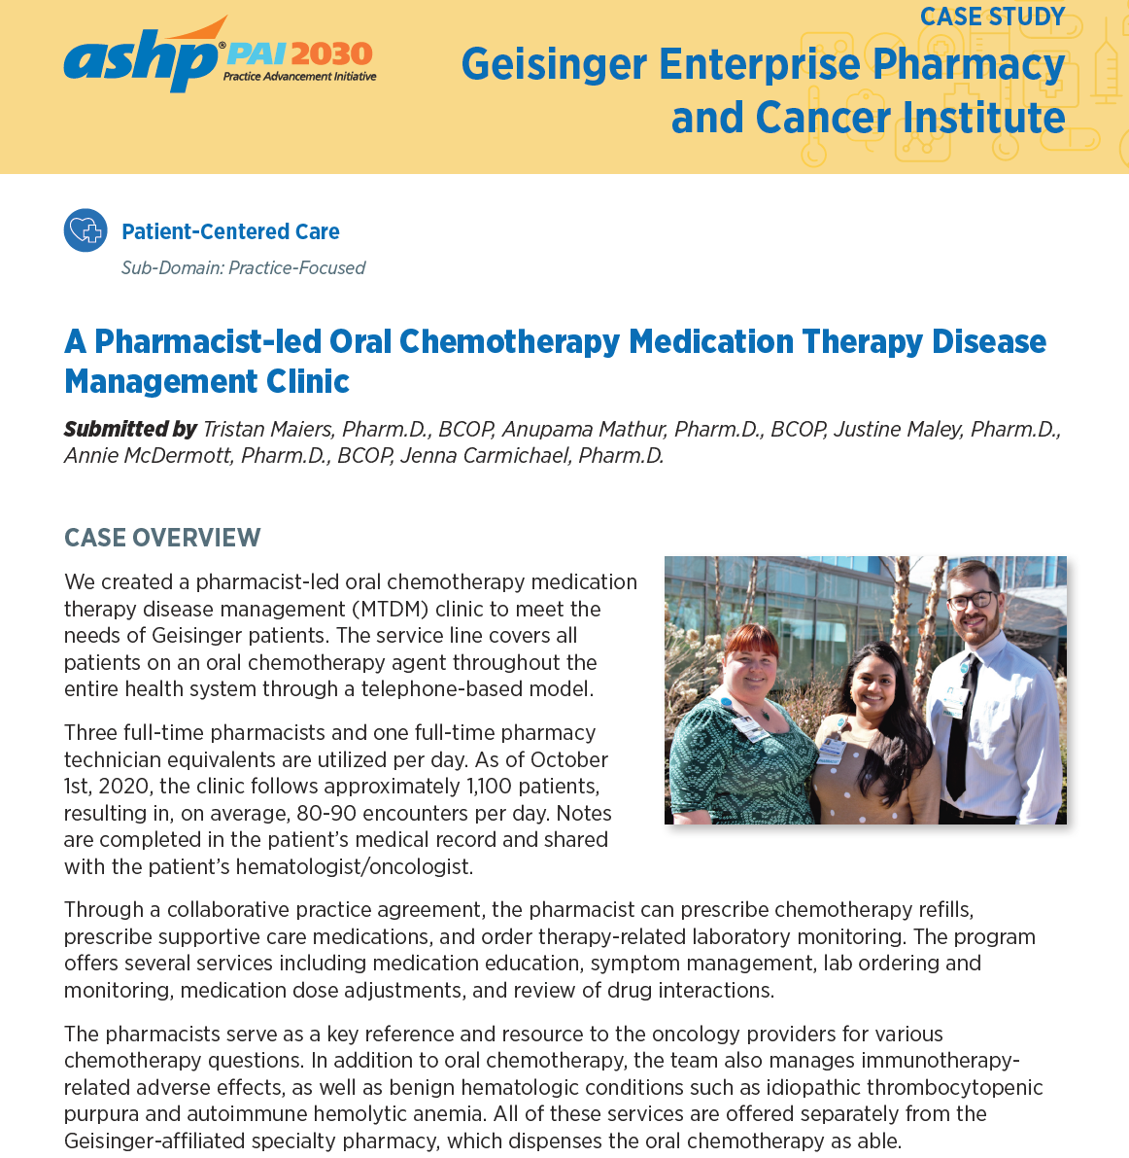
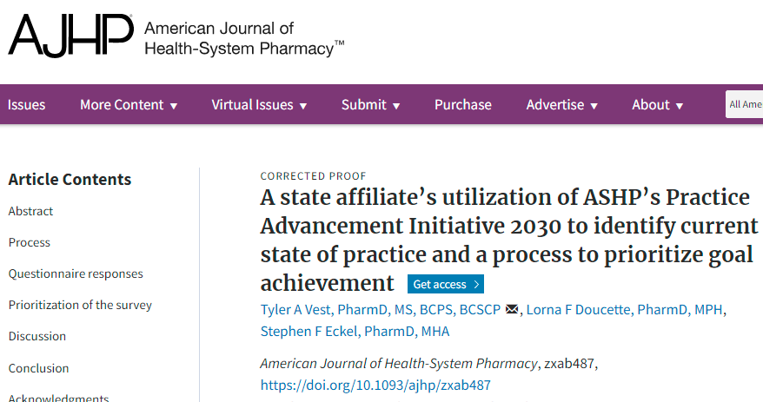
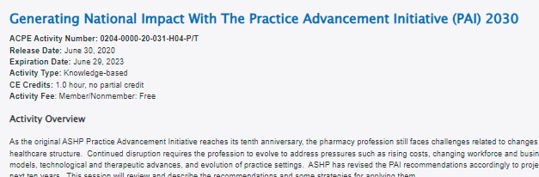
Telling the Story
Share your ideas, initiatives, and successes:
Case studies
Podcasts
Webinars
Publications
Posters
Networking
Playbooks, toolkits
Education at local, state, & national meetings
Notes:
Follow up meeting slide
Highlight what your state can highlight and/or has already produced.

Slide 39
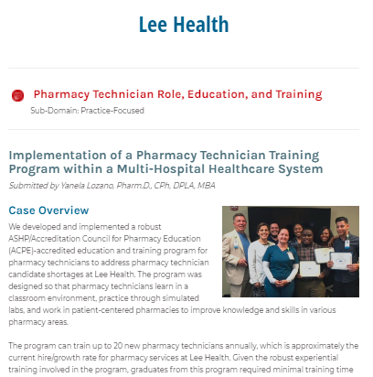
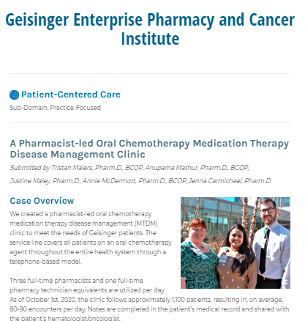
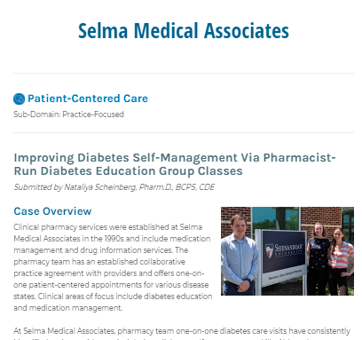
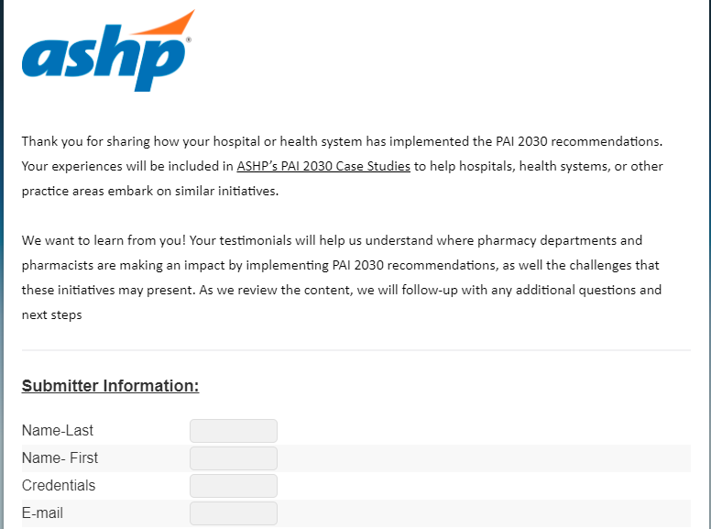
PAI 2030 Case Studies
Submit a case study on line:

Slide 40
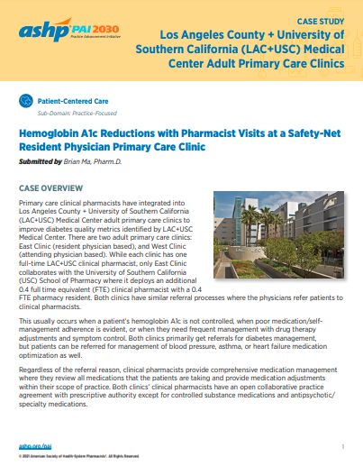
PAI 2030 Case Study Outline
Select domain and sub-domain
Case overview
Key elements
Impact on patient outcomes
Pharmacy and pharmacist roles
Lessons learned
Budget and resource allocation
Future goals
Notes:
When submitting a case study, these are the elements that would be requested.
If you're working on anything that is advancing any of the initiatives ASHP would love to hear about what you're doing and about the outcomes of your work.

Slide 41
How can ASHP help?
Advocacy and messaging
Channeling engagement through ASHP Sections and Forums
Help creating podcasts
Education
Professional policy needs (ASHP Councils)
Notes:
Advocacy and messaging
Education
Channeling engagement through ASHP Sections/Forums
Professional policy needs (e.g., policy topic ideas for ASHP Councils)

Slide 42
Key Takeaways
PAI 2030 introduced 59 contemporary recommendations that reflect changes and anticipate trends in the healthcare environment
PAI 2030 focused initiatives monitor the progress toward achievement
Use PAI 2030 Self-Assessment Tool to probe key components of a strategy and as a baseline for practice improvements
Notes:
PAI 2030 introduces 59 contemporary recommendations that reflect changes and anticipate the trends in the healthcare environment. While we did not talk about all 59 recommendations, I hope to have given you a flavor for the kinds of things that are in there, and the future-focused perspective that they take on the things that we should think about over the next decade. Likewise, there are a host of resources that are available to support you as you advance practice.

Slide 43
Questions or Comments?
If you have any questions or comments related to ASHP’s PAI 2030, please send an email to pai@ashp.org.
Notes:
If you have any questions or comments, feel free to contact us or ASHP (contact email on slide) as we would be happy to answer any questions. If you are interested in the self-assessment tool and have any questions, again, they would be happy to help you. We want to hear from you and what you are doing, because you will do some amazing things.

Slide 44
Notes:
I want to thank you for taking the time to listen to this presentation.
I wish you all the best as you kick off your PAI 2030 efforts to find ways to leverage opportunities to advance the profession and improve patient health and well being over the next decade.

