Slide 1
Medication Safety for Nurses MODULE 3
Presented by: [insert name]
Date: [insert date]

Slide 2
OUTLINE
HAM and LASA Strategies
Nursing Led Protocols
Compounding Safety
Controlled Substances
Photo from Microsoft stock images - available as a Microsoft 365 subscriber

Slide 3
High Alert Medication (HAM) and Look-Alike Sound-Alike (LASA) Strategies
Photo from Microsoft stock images - available as a Microsoft 365 subscriber

Slide 4
High Alert Medications
Definition: High Alert Medications are drugs that bear a heightened risk of causing significant patient harm when used in error.
Examples: Insulin, heparin, and chemotherapy *Refer to your institutional policy
Relevance: Importance of proper storage, ordering, dispensing, administration, and monitoring (consider the entire medication use process) to ensure patient safety
Image generated on MidJourney by author
REFERENCES: 1) Centers for Medicare and Medicaid Serivces. Conditions of Participation for Hospitals. §482.25 2) Institute of Safe Medication Practices. ISMP List of High-Alert Medications in Acute Care Settings (2018).

Slide 5
High Alert Medications – POLICY
[INSERT INSTITUTIONAL HIGH ALERT MEDICATION POLICY OR GUIDANCE HERE]

Slide 6
High Alert Medications – ERRORS
[LIST INSTITUTION-SPECIFIC ERROR EXAMPLES RELATED TO HIGH ALERT MEDICATIONS AND WHAT WAS DONE TO PREVENT FUTURE ERRORS]

Slide 7
High Alert Medications – Key Policy Points and Risk Mitigation
Key Policy Points
High Alert Medications come from multiple sources
CMS CoP require each hospital to keep a current list of high-alert medications
Each hospital may be slightly different
System-Level Risk Mitigation
Require that certain medications can ONLY be ordered in specified order sets (example: PCAs through pain order sets)
Store items only in Pharmacy or locked-lidded bins
Maintain short list of medications requiring an Independent Double Check
Build in hard limits in infusion pumps
Person-Level Risk Mitigation
Read and adhere to High Alert Medication Policy
Double check medication names and routes of administration
Report errors and near-misses for more resilient systems
Engage in ongoing education regarding high alert medications
Should include a combination of different risk mitigation strategies
Clarify where medications can be administered and under what conditions (e.g. telemetry)
Comply with standard processes
ABBREVIATIONS: CMS CoP=Centers for Medicare & Medicaid Services Conditions of Participation; PCAs=Patient Controlled Analgesia
REFERENCES: 1) Am J Health Syst Pharm. 2022;79(4):218-229 2) The Joint Commission. MM.03.01.01

Slide 8
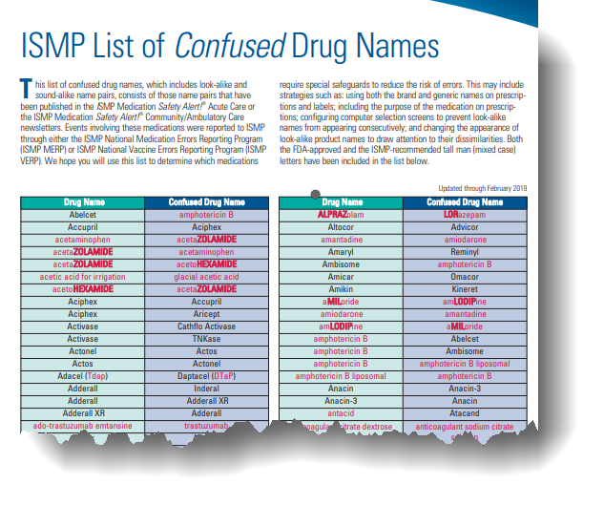
Look-Alike Sound-Alike Medications
System-Level Risk Mitigation
Separate and segregate within both Pharmacy and ADCs
Utilize different packaging for look-alike, sound-alike medications
Use TALLman lettering with consistency across all systems (e.g. from EMR to ADCs to infusion pumps)
Standardize order sentences within the EMR
Employ hard stops within the EMR for Dosage-form and frequency mismatches
Restrict routes of administration for look-alike, sound-alike medications within the EMR
Person-Level Risk Mitigation
Scan medications through BCMA prior to administration
Be familiar with your organization's look-alike, sound-alike medication list
Use auxiliary labels judiciously to maximize impact
Confirm indication prior to administration
Pause and review when prompted by TALLman lettering and/or auxiliary labeling
Consider items outside of medications as well – NaturaLyte vs Golytely error (see reference #2)
Report any incidents or potential risks related to Look-Alike, Sound-Alike Medications
ABBREVIATIONS: ADC=Automated Dispensing Cabinets; EMR=electronic medical record; BCMA=barcoded medication administration
REFERENCES: 1) Institute for Safe Medication Practices (ISMP). ISMP List of Confused Drug Names. ISMP; 2023. 2) Institute for Safe Medication Practices (ISMP). Patient death tied to lack of proper escalation process for barcode scanning failures. ISMP Medication Safety Alert! Acute Care. 2023;28(19):1-3.

Slide 9
Look-Alike Sound-Alike Medications – MEDICATION LIST and/or POLICY
[INSERT INSTITUTIONAL LOOK-ALIKE SOUND-ALIKE MEDICATION LIST AND/OR POLICY HERE]

Slide 10
Look-Alike Sound-Alike Medications – ERRORS
[LIST INSTITUTION-SPECIFIC ERROR EXAMPLES RELATED TO LOOK-ALIKE SOUND-ALIKE MEDICATIONS AND WHAT WAS DONE TO PREVENT FUTURE ERRORS]

Slide 11
Safe Practices for Injectable Medication Preparation
Image Created in DALLE-3
Notes:
This Photo by Unknown author is licensed under CC BY-NC-ND.

Slide 12
Safe Practices for Injectable Medication Preparation
Use aseptic technique in a designated medication preparation area as defined for your institution
Use supplies appropriate to the medication and dose e.g. use insulin syringes for insulin only, use correct sized syringe, use Luer Lock syringes as appropriate
Verify the order for medication dosage and vial concentration
Use the correct diluent and volume
Do not reconstitute or draw up medication using a normal saline flush
Ensure final volume and concentration should match order
Label syringe if not immediately administered by the same person who prepared the syringe

Slide 13
INSTITUTION-SPECIFIC INFORMATION
[INSERT INSTITUTION SPECIFIC INFORMATION
EXAMPLES: RELATED POLICIES;
INFORMATION AROUND HOW CONTINUOUS DRIPS ARE REPLENISHED]

Slide 14
Controlled Substances
Photo from Microsoft stock images - available as a Microsoft 365 subscriber

Slide 15
What is Drug Diversion?
Illegal distribution or abuse of any prescription drugs or their use for purposes not intended by the prescriber
[Insert how institution monitors for drug diversion]
Examples: stealing waste, diluting a medication, substituting a medication
[Insert where to report concerns at your institution]
Drug diversion presents a risk to patient safety – e.g. patient not receiving appropriate pain control
Your role in monitoring for drug diversion is to speak up if you have concerns
U.S. Department of Health and Human Services. Centers for Medicare & Medicaid Services. Center for Program Integrity. (2012, January).
Notes:
Retrieved from: Drug Diversion in the Medicaid Program, State Strategies for Reducing Prescription Drug Diversion in Medicaid, August 2011 (cms.gov)

Slide 16
Best Practices
Do...
DO NOT...
Pull medications from ADC against patient order. Override should be used only in emergency.
Document partial waste immediately.
When witnessing waste, ensure you are visually seeing medication being wasted.
Chart all dispenses at time of administration.
Give pain medication according to ordered scale.
Provide documentation/explanation for whole dose wastes.
Waste or return to ADC if not needed/refused.
Resolve all ADC discrepancies at end of shift.
… chart medication before given.
… hand off medications.
Should only be done in emergent situations.
You are responsible for what you dispense from the ADC.
… remove medications excessively early.
*Per institution policy
…hold medications for long periods.
ADC: automated dispensing cabinet

Slide 17
Perfection is not attainable, but if we chase perfection, we can catch excellence. – Vince Lombardi (American Football Player, Coach, NFL Executive)

