Slide 1
ASHP: Working on Behalf of Hospital and Health-System Pharmacists
Deanna Tran, PharmD, BCACP
Director, Member Relations

Slide 2
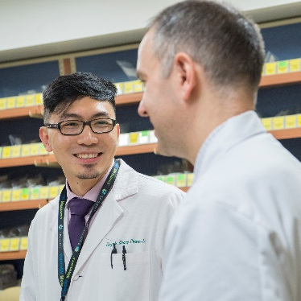
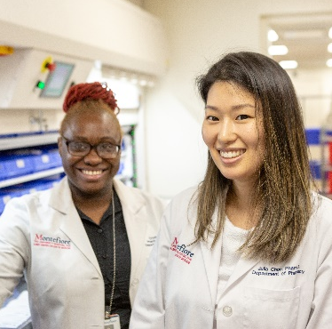
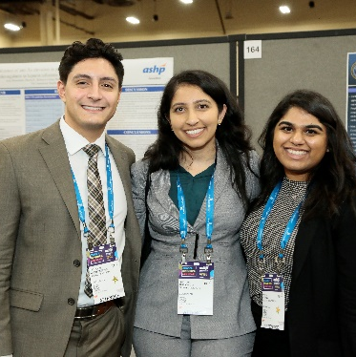
Who is ASHP?
ASHP serves its members as their collective voice on issues related to medication use and patient safety
Mission: To help people achieve optimal health outcomes
Vision: Medication use will be optimal, safe, and effective for all people all of the time
Notes:
ASHP is the collective voice of pharmacists who serve as patient care providers in hospitals, health systems, ambulatory clinics, and other healthcare settings spanning the full spectrum of medication use.
Founded in 1942. ASHP has championed innovation in pharmacy practice, advanced education and professional development, and served as a steadfast advocate for members and patients For over 80 years
Notes:
In addition, ASHP is the accrediting body for pharmacy residency and technician training programs, and provides comprehensive resources to support pharmacy professionals through every stage of their careers.
Headquarters in
Bethesda, MD
200+ Staff
Elected Board of Directors and Officers

Slide 3
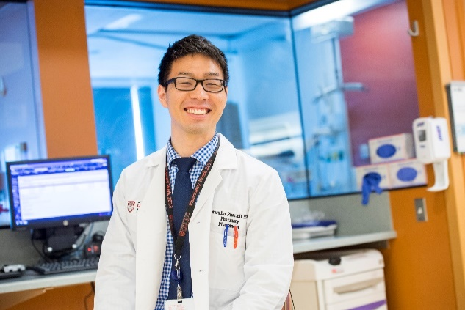
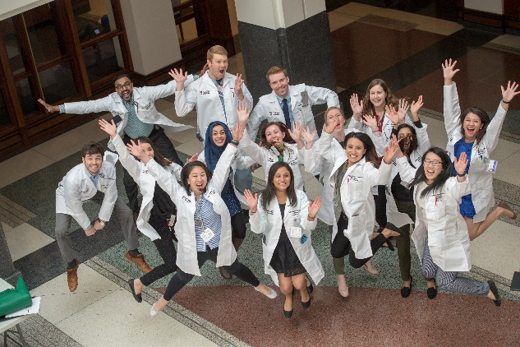
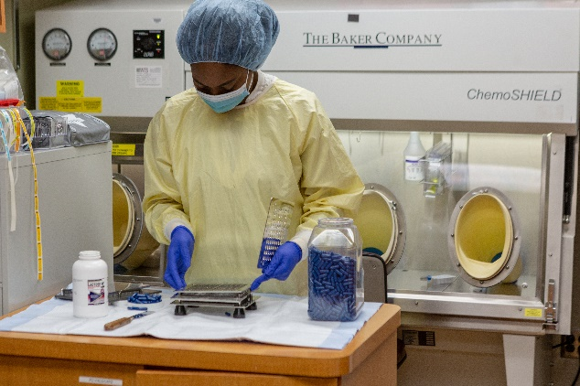
Our Members
Pharmacists
Student Pharmacists
Pharmacy Technicians
65,000
Notes:
Represent pharmacists and technicians Who Serve as Patient Care Providers in Acute and Ambulatory Settings – including hospital, ambulatory care, and health-system community pharmacies
Represent students interested in hospital and health-system, residency, and fellowship
Together we make over 65,000 members, making ASHP the largest association of pharmacy professionals in the United States
As a student – the networking

Slide 4

Our Core Strengths
Providing leadership on professional issues
Publishing evidence-based drug information
Developing practitioner educational programs
Conducting conferences and meetings
Advocating public policy for the pharmacy workforce

Slide 5
ASHP Key Initiatives
Well-Being and Resilience
ASHP National Awareness Campaign
Preparation of Pharmacy Workforce

Slide 6


Notes:
First key initiative is fostering and sustaining wellbeing and resilience engagement of pharmacists, pharmacy residents, student pharmacists, and pharmacy technicians.
We’ve been working closely with other national organizations including the National Academy of Medicine’s Action Collaborative on Clinician Well-Being and Resilience to address critical workforce and patient care issues
QR code will take you to our wellbeing & you webpage. It includes learning activities – learning bursts (short presentations) so you’re informed on the issues so that you can take action on your own wellbeing, and assist others including contribution to your institution, webinar and podcasts
Wellness Resources
And to take action including taking the pledge to commit to improving clinician well-being and reducing clinician burnout, to being an ASHP well-being ambassador.
Notes:
A key focus of ASHP includes well-being and resilience:
ASHP is committed to fostering and sustaining the well-being, resilience, and professional engagement of pharmacists, pharmacy residents, student pharmacists, and pharmacy technicians.
As an original sponsor of the National Academy of Medicine’s Action Collaborative on Clinician Well-Being and Resilience, ASHP is proud to represent pharmacy in interprofessional efforts to address this critical workforce and patient care issue.

Slide 7

Notes:
In 2024 ASHP, with the support of the ASHP foundation, launched We're Your Pharmacist, our national public awareness campaign.
It’s main goal is to shine a spotlight on the critical contributions hospital and health-system pharmacists make to patient care each and every day as essential patient care providers.

Slide 8

Get Involved in We’re Your Pharmacist
Share yourpharmacist.org to family, friends, coworkers, and colleagues
Share our posts on your social media networks
Share your story at ashp.org/yourstory
Take the quiz to see which health-system pharmacy specialist you could be!

Slide 9
ASHP Accredited Residencies
Residency accreditation is an important driver for excellence, serving as a bridge between education and practice.
Notes:
Lastly, in regards to preparation of the pharmacy workforce….one of the largest initiative is in regards to ashp accredited residencies. ASHP is the only nationally recognized non-governmental, non-profit pharmacy association that has been accrediting pharmacy residencies since 1962
Accreditation is a peer-review quality improvement process. This process measures compliance with standards developed by practitioners, and therefore assures a LEVEL AND quality TRAINING experience for the resident. Because accreditation requires significant time and money, it demonstrates institutional commitment to excellence in training. Basically, accreditation is a “seal of approval” for a residency program.

Slide 10
Student Membership
ASHP is here to support you every step of the way through your pharmacy journey.
Notes:
Never too late
ASHP member as a student but regret not being more involved knowing now what I know

Slide 11
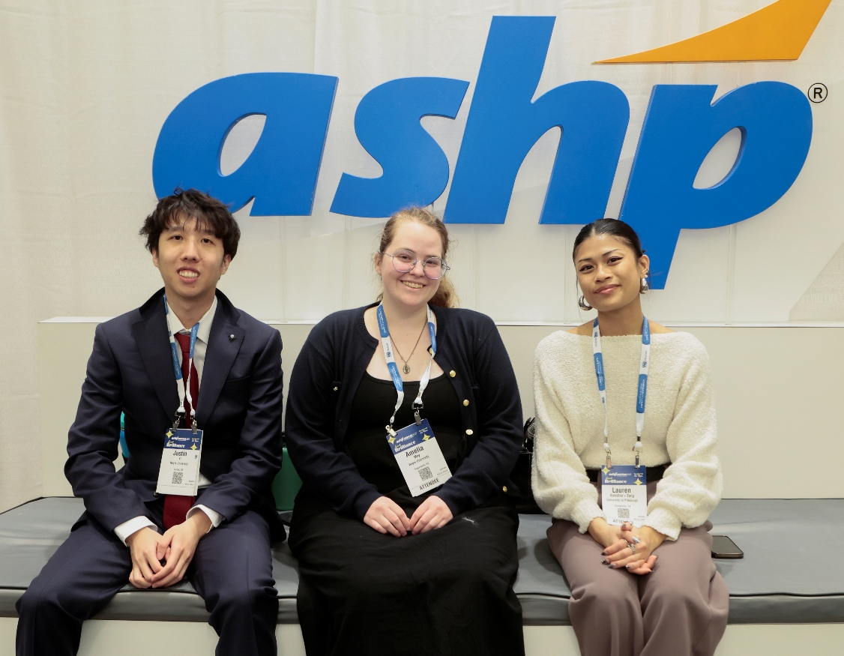
National Membership
Provides you connections across the country
Learn more about advanced specialties, hospital and health-system pharmacy
Gain the advantage in preparing for residency
Gain the skills every pharmacy leader needs
Give your voice a national voice
Stay up-to-date on industry trends
Notes:
ASHP provides you personal connections
Opportunity to collaborate, meet, and connect with people across the country
Pharmacy is a small world - Join a national network with possibilities for opportunities, collaborations, and connections to meet future employers or residency directors, and co-workers
Clinical career
Learn more about advanced pharmacy specialties and how to prepare for your career goals
Residency
Ashp is leader in residency prep and training, and clinical specialities
Many tools on the website, roundtable events esp Phase I and Phase II
Skills
Prepares students for practical leadership skills (professional development/power skills/career readiness)
Leadership training
CV & interview prep
Public speaking/communication (elevator pitch, networking with genuine intention, interviewing)
Advocacy
Voice
Advance the profession
Advocacy. Be a part of advancing the profession
Stay up to date on industry trends
know what’s happening on the federal level, scope of practice issues, changes in guidelines, sharing of best practices

Slide 12
Assisting You At Every Stage
P1 Student
Update your CV now that you’re a NP
New Practitioner
Utilize board certification study materials
Improve your preceptor skills with development tools
Get real career insights from advanced specialists
P2 – P4 Student
FREE membership!
Explore health-system careers
Learn about pharmacy residency
Build your professional CV with our help
Resident
Start residency preparation early with resource guides
Get interview-ready with resources
Get APPE ready with how-to Journal Club toolkit
Use the residency project Templates
Utilize personal financial management resources
Attend Live and on demand CE
Notes:
ASHP is here for you during each step of your professional journey
Highlighted here are a few of the many resources that are available to our ASHP members
The next few slides I am going to highlight a few resources I think could be useful now, and as you prepare for what is next after pharmacy school
CV transition guide

Slide 13
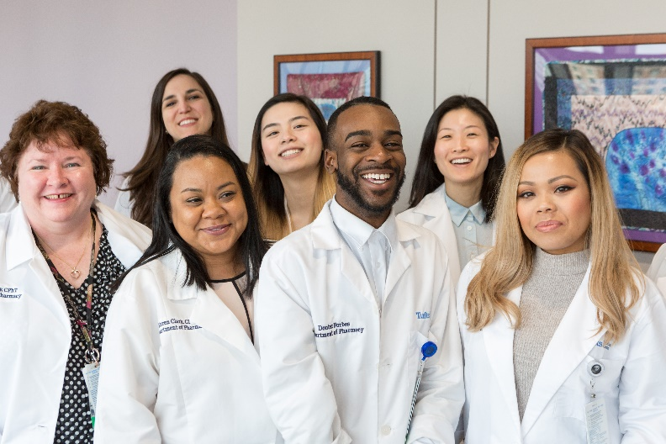
Sections and Forums
Sections
Forums
Ambulatory Care Practitioners (SACP)
Clinical Specialists and Scientists (SCSS)
Community Pharmacy Practitioners (SCPP)
Digital and Telehealth Practitioners (SDTP)
Inpatient Care Practitioners (SICP)
Pharmacy Educators (SPE)
Pharmacy Informatics and Technology (SOPIT)
Pharmacy Practice Leaders (SPPL)
Specialty Pharmacy Practitioners (SSPP)
New Practitioner (NPF)
Pharmacy Student (PSF)
Notes:
Once you’re a member, as a student you become part of the pharmacy student forum.
Forums are communities for colleagues in a similar career demographic and automatic membership occurs for students, technicians, and new practitioners. May also be involved in the Sections
I think of PSF it as ASHP’s pharmacy home for students. The PSF represents student pharmacists, to provide professional development resources, and develop an engaged community that will lead and advocate for the pharmacy profession
Once you’ve graduated from pharmacy school you would automatically be a part of the new practitioner forum
Your membership also allows you to join 9 different sections. Self-select. ASHP’s Sections are communities where colleagues who share similar practice-interests are able to network and share ideas.

Slide 14

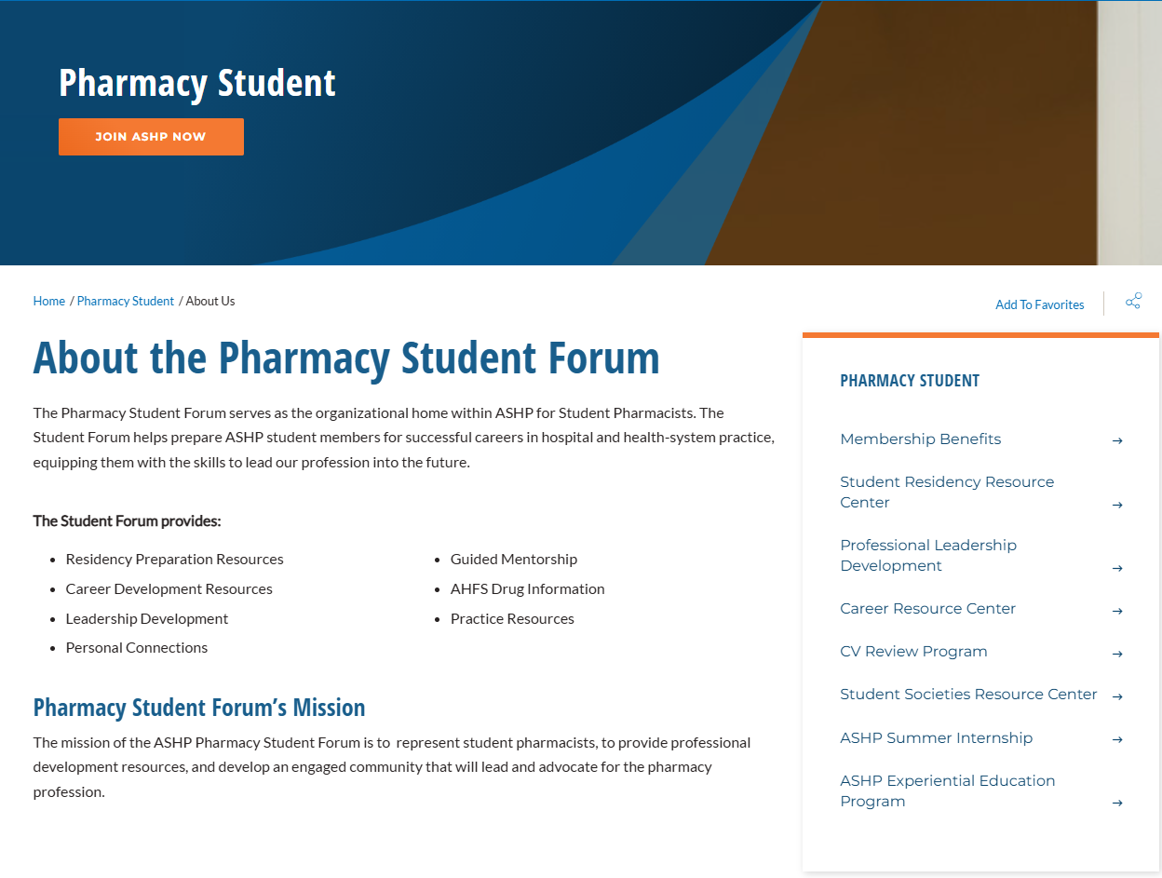
Pharmacy Student Forum
Notes:
You can learn more about the PSF on our website. It has many links as you can see to our programs and resources.
I’m going to go over some of the key member benefits that you have

Slide 15



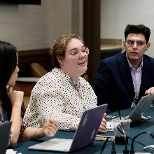
Pharmacy Student Forum
Virtual Webinar, Roundtables & Podcasts
Microcredentials
Midyear Clinical Meeting & Pharmacy Futures
Volunteer Leadership Opportunities
Notes:
We have so many resources, tools, activities, and programs for students. I could be here for ages if I tried to share all of them. I’m going to give you some big highlights but also to give you a glimpse of how we have many different avenues so that everyone can find something that interests them and meet their needs
4 big buckets

Slide 16
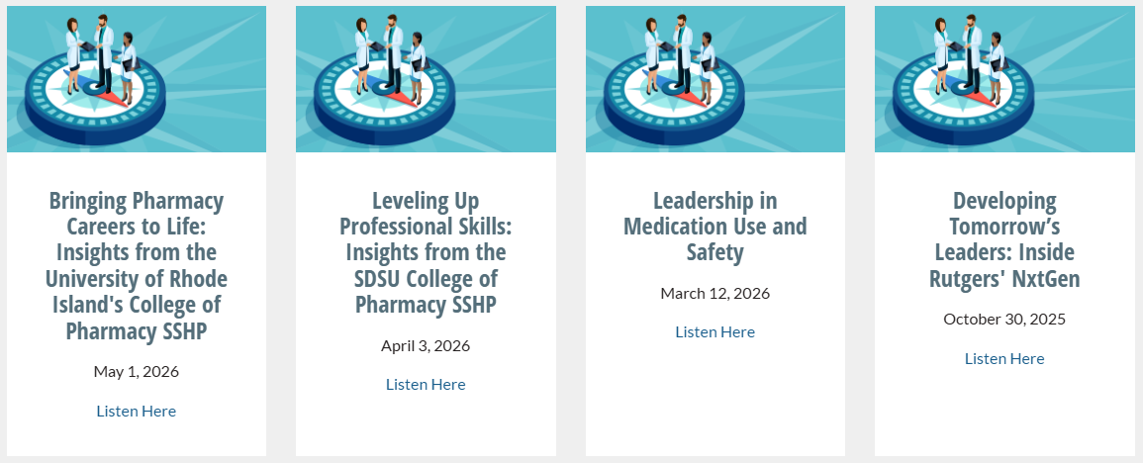
Pharmacy Student Forum
Residency Preparation Roundtable Series
Phase II Residency Roundtable
Webinar: Navigating & Preparing for Interviews: Strategies for Success
Podcasts: Tips and Tricks for APPEs and Internships
Virtual Webinar, Roundtables & Podcasts
https://www.ashp.org/professional-development/ashp-podcasts
Notes:
By AGs, from NPF, and other pharmacist AG

Slide 17
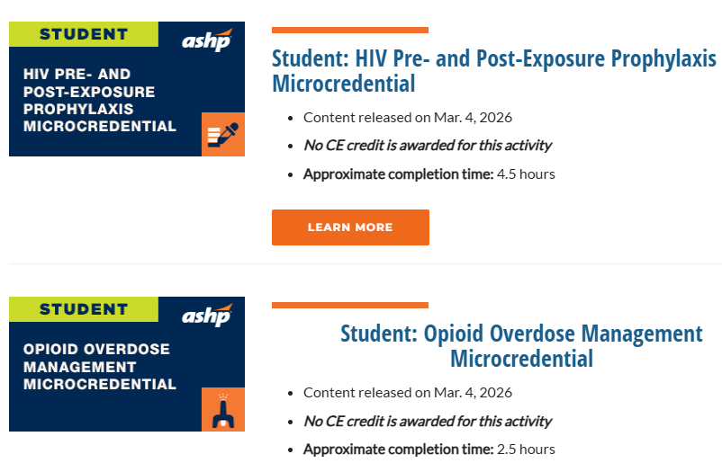
Pharmacy Student Forum
Quick, impactful learning for busy students
2-6 hours of training
Obtain a Credly digital badge to share on social media upon completion
Microcredentials
https://www.ashp.org/professional-development/ashp-microcredentials#student
Notes:
Low cost $49 as a member

Slide 18

Pharmacy Student Forum
Over 10 student sessions
2 days of Residency Showcase
Industry Fellowship Open House
Student Society Showcase (Networking Session)
Student Kickoff & Midyear Workshop: Science of Networking
5 Student Poster Sessions
Midyear Clinical Meeting & Pharmacy Futures
https://midyear.ashp.org/

Slide 19
Pharmacy Student Forum
Over 90 volunteer opportunities
Volunteer Leadership Opportunities
https://www.ashp.org/pharmacy-student/professional-leadership-development/psf-leadership

Slide 20
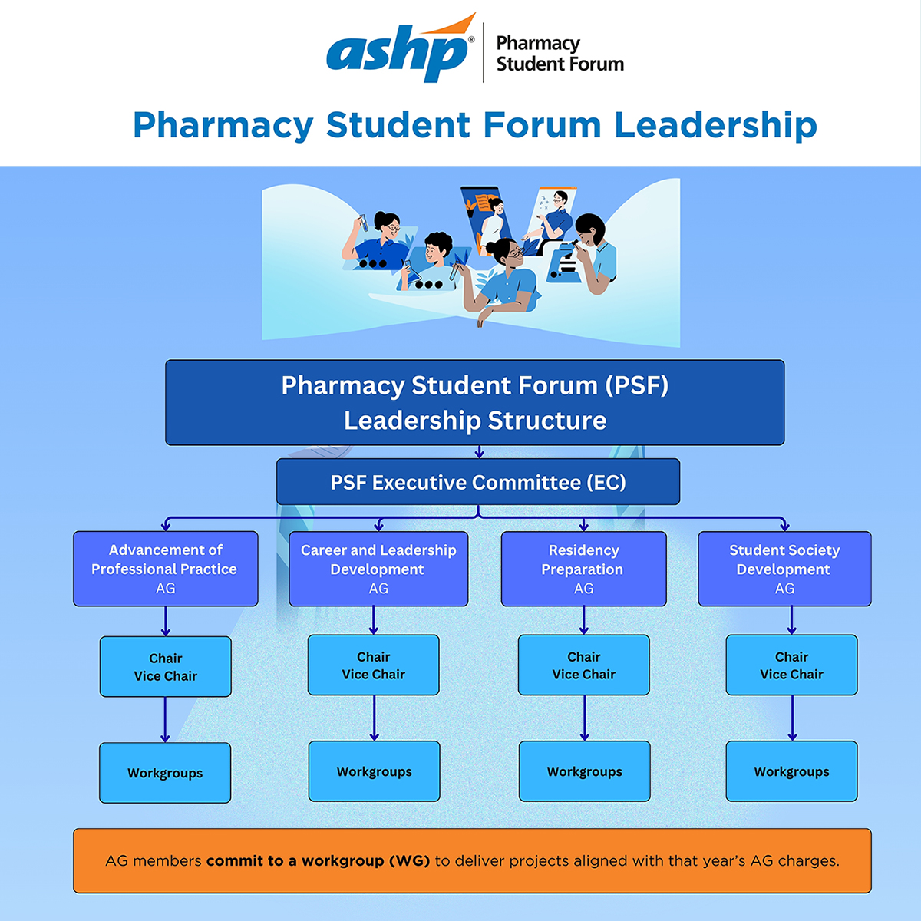
Notes:
**change leadership structure
EC (5) and AG (almost 80 opportunities) Councils and Commissions
Work on projects for students by students to meet their needs. This includes projects for advamceent of pharmacy practice, tools for SSHPs, residency training, career and leadership development. Ranging from P2-P4s. Applications are currently open

Slide 21
PSF Volunteer Leadership Opportunities
PSF Executive Committee
(Applications open in Sept)
  Represents the Forum and provides strategic direction
  Serve as Executive Committee Liaison to the Advisory Groups
PSF Advisory Groups
  (Applications open in Feb)
  Completes charges including development of resources and tools such as webinars, tip sheets, and roundtables
Councils and Commissions
(Applications open in Sept)
  Primary bodies that initiate ASHP policies, advises the Board of Directors on issues
https://www.ashp.org/about-ashp/our-leadership/councils-and-committees
Notes:
Sept, close in mid-nov. 5 executive committee members.
P4s – have NPF
Feb – closes early may. 80 advisory group members.
Councils and committees. ASHP has 5 councils, who ae the primary bodies that initiate ASHP policies on professional issues. Policy recommendations are reviewed by the Board of Directors and, ultimately, by the House of Delegates. Councils also advise the Board on ASHP activities within their respective purviews.
Commissions advises the board of directors on items like affiliate relations, credentialing, goals, and technician accreditation
One student rep for council and also serves on commission on affiliate relations
These are all application and board appointed positions
**Spotlight
**Engagement Opportunities

Slide 22
Resources & Tools
Preparing the next generation of health-system pharmacists
Notes:
ASHP is focused on ensuring the next generation of pharmacist are well-prepared to succeed in their career

Slide 23
Professional Development
Career
Resource Center
Student Leadership Development
Student Residency Resource Center
Resource Centers

Slide 24
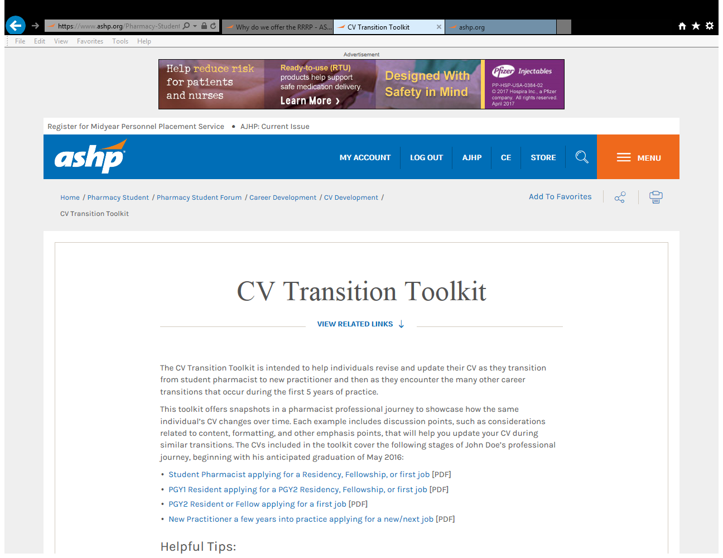

Career Resource Center
Curriculum Vitae (CV) resources
  How to Prepare a CV
  CV Transformation through Career Changes
  Tips for Writing A Cover Letter
Careers in Health-System Pharmacy
    We’re Your Pharmacist Career Quiz
    Careers in Pharmacy Videos
Networking and Mentorship
  Navigating Networking: Tips for Conference Success
  Pharmacy Student Forum’s Connect Community
  Mentorship Resource Center
https://www.ashp.org/pharmacy-student/career-resource-center

Slide 25
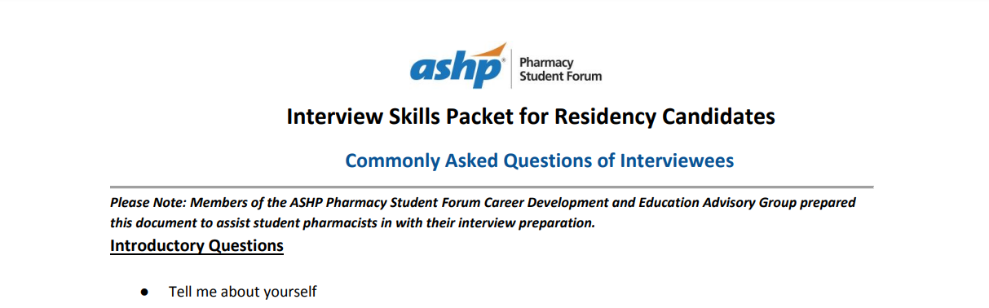


Student Residency Resource Center
Over 100+ resources from day 1 of your P1 year through Phase II & Scramble of your P4 year, including
  General residency info
    Road to Residency A Guide for P1-P3 Students
  Application Timeline and Logistics
    Residency Candidate Guide, Master Residency Preparation Spreadsheet, Finding Your Best Fit Residency Program Worksheet
  Application Materials Preparation
    Step by step guide on PhORCAS application
    HSPAL Residency Candidate Guide
  Match Day Resources
  Residency Interview Preparation
    Comprehensive Residency Interview Guidebook
https://www.ashp.org/professional-development/residency-information/student-residency-guide

Slide 26

Student Leadership Development
Student Leadership Development Workshop
ASHP Pharmacy Forecast Workshop
Leadership Journal Club
How to Conduct a Journal Club
https://www.ashp.org/pharmacy-student/career-resource-center/career-development/student-leadership-development
Notes:
Workshops predeveloped and can be taught by anyone
Resource to assist indiv have leadership journal club
Includes outlines and examples, recommended articles and books
Journal club resources
Tips for a Standout Journal Club Presentation
Example Journal Club Template

Slide 27
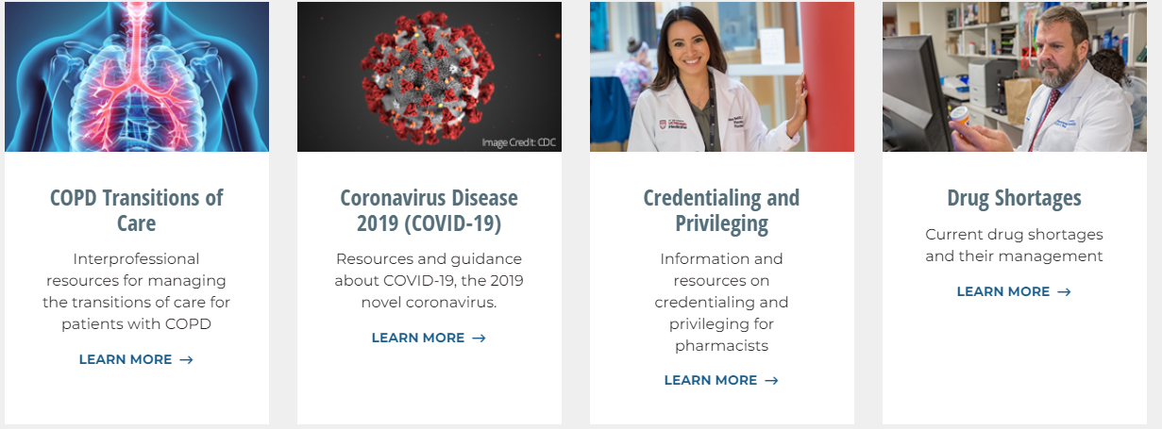
Resource Centers
47 resource centers and counting!
  Resource center topics range from Ambulatory Care to Workforce Well-Being and Resilience
Notes:
Resource Centers to Meet Your Professional Needs
Your membership grants you access to every resource on the website.

Slide 28
Programs
Member-benefit resources and activities to prepare the next generation of pharmacists

Slide 29



Programs
CV Review Program
Guided Mentorship Program
Career-Pharm®
www.ashp.org/CVreview
https://www.ashp.org/pharmacy-student/career-resource-center/career-development/guided-mentorship-program
https://www.ashp.org/professional-development/careerpharm
Notes:
CV review:
Bi-annual program for students and new practitioners
Receive feedback from outside your network
The ASHP Guided Mentorship Program
6-month program designed to connect student pharmacists and new practitioners with practitioner mentors who can provide advice, guidance, and knowledge related to professional development, post-graduate pursuits, and ongoing career progression through structured one-on-one mentor/mentee relationships.
Opens mid-August
Careerpharm
includes job postings and internships
Free virtual career fairs where you can talk to employers who are actively hiring

Slide 30
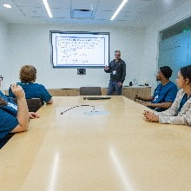


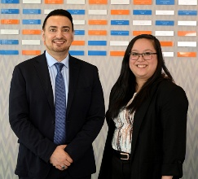
Programs
Outreach Presentations
Summer Internship Program
Executive Fellowship
APPE Rotation
Notes:
SSHP outreach presentations such as how to prepare for midyear, how to prepare for residency
Summer internship program
APPE rotation. 4-6 week rotations, virtual
Executive fellowship – it’s a fellowship in Association Leadership and Management. It’s a paid 12-month program that provides fellow(s) each year with hands-on training in all facets of not-for-profit association leadership and management.

Slide 31

Student Programs
ASHP Clinical Skills Competition
ASHP Student Leadership Award
Administered by ASHP, funded by ASHPF
Administered by ASHP, funded by ASHPF
ASHP Foundation Student Literature Award
ASHP Foundation Professional Advancement Scholarship
Recognizes published research by a pharmacy student
Supports attendance to the Midyear for graduating pharmacy students
Notes:
CSC – team-based analysis of clinical scenarios. Conducted at local SSHPs, and then the national level competition is held at midyear. All national CSC participants get complimentary registration to MCM, and top teams receive some great benefits including a monetary honorarium.
Student leadership award recognizes students with an interest in pharmacy practice in health-systems who have demonstrated exceptional leadership ability. Includes a $2000 award
Student literature award recognizes pharmacy student for a published paper on a completed research project. Has to be 1st or 2nd author. Includes a monetary honorarium
Professional advancement scholarship
Very competitive scholarship. Provides partial support for graduating pharmacy students attending midyear to support their networking and professional development opportunities.

Slide 32
Assisting You At Every Stage
Student
CV Transition Toolkit
Residency Project Templates
Research Resource Center
Mentorship Resources
Personal Financial Management
PGY1 → PGY2 and Residency→ Workforce Transition Guides
New Practitioner
Board Certification Resources and Study Materials
Preceptor Development Tools
Live and on demand CE
Networking Opportunities
Advice from seasoned practitioners
Leadership Development
Road to Residency: A Guide for P1-P3 Students
Entering Phase II of the Match
Resident
HSPAL Residency Candidate Guide
Job Search and Interview Advice
Student Loan Debt Management 101
Notes:
ASHP is here for you during each step of your professional journey
Highlighted here are a few of the many resources that are available to our ASHP members
The next few slides I am going to highlight a few resources I think could be useful now, and as you prepare for what is next after pharmacy school
CV transition guide

Slide 33
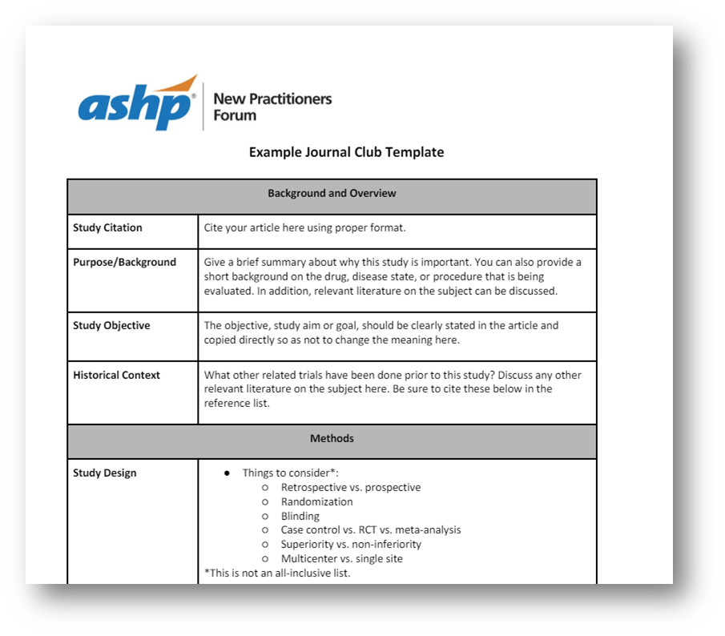
Elevate Your Journal Club Skills: Templates and Expert Insights
Tips for a Standout Journal Club Presentation
Example Journal Club Template
Podcast: Best Practices for Preparing and Presenting a Journal Club
Notes:
Are you preparing for upcoming rotations or internships and need tips on creating a standout journal club presentation? Start with our example journal club template, which offers clear guidance on what to include in your handout and how to organize your content effectively. Then tune in to our podcast, Best Practices for Preparing and Presenting a Journal Club, for expert advice and actionable insights to elevate your presentation skills.

Slide 34

ASHP Guided Mentorship Program
Designed to connect student members and new practitioners with experienced practitioners ​
Provides a space for professional advice, guidance, and knowledge towards developing a professional career​
Fosters a professional relationship to facilitate professional development, career management, and network building​
Applications for the next program cycle will open mid-August
www.ashp.org/guidedmentorship
Notes:
The ASHP Guided Mentorship Program is a 6-month program designed to connect student pharmacists and new practitioners with practitioner mentors who can provide advice, guidance, and knowledge related to professional development, post-graduate pursuits, and ongoing career progression through structured one-on-one mentor/mentee relationships.
The program aims to strengthen the pharmacy workforce by supporting the development of a diverse pipeline of new pharmacy practitioner leaders

Slide 35

Questions?
students@ashp.org

