Slide 2
ASHP OPENS DOORS
Tyler’s video

Slide 3
AGENDA
Why join as a student pharmacist?
How do I get involved with ASHP?
Who is ASHP?

Slide 4

MISSION
To help people achieve optimal health outcomes by advocating and supporting the professional practice of pharmacists.
VISION
Medication use will be optimal, safe, and effective for all people, all of the time.

Slide 5

Who is ASHP?
ASHP serves its members as their collective voice on issues related to patient care, medication use,
and public health

Slide 6

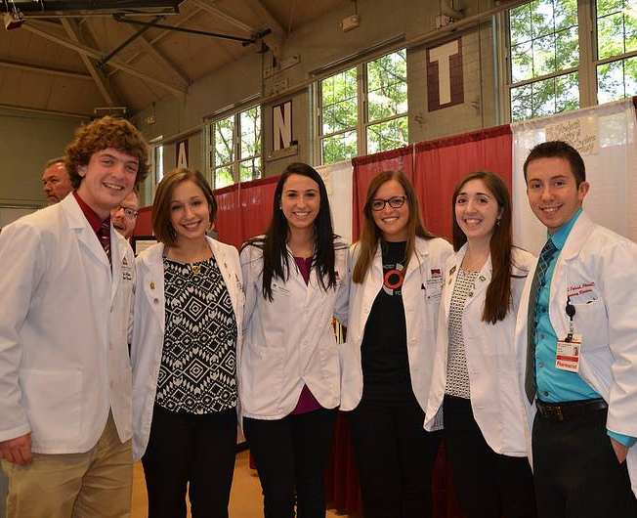

Our Members
Pharmacists
Student Pharmacists
Pharmacy Technicians
58,000

Slide 7
ASHP, State Affiliate, and SSHP
ASHP
State Affiliates
SSHP
Get involved on the national level to broaden your professional network and leadership opportunities
Get engaged with key issues and build connections with active practitioners and
other students at the state level
Get involved in your Student Society of
Health-System Pharmacy on campus and
develop your leadership skills

Slide 8
Why Join ASHP as a Student Pharmacist?
Network
Explore
Enhance
Volunteer
Advocate
Present

Slide 9


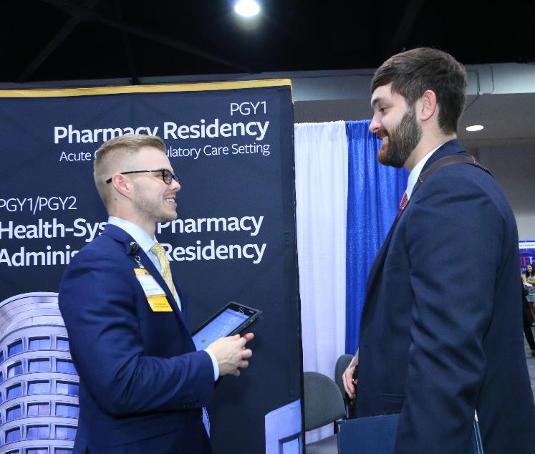
Explore Your Career Options
Discover your career path
Learn about the pharmacy profession
Get the resources you need to succeed
ASHP provides high quality resources to help you excel
Refine your professional image

Slide 10


Build Your Network
Learn from world-renowned speakers at national meetings
Build relationships with pharmacists and student pharmacists nationally
Receive one-on-one mentoring through ASHP Connect Mentor Match

Slide 11

Enhance Your Skills
Participate in the member-only curriculum vitae (CV) review service
View live or on-demand webinars to help you stand out from the crowd
Access online interview tools
Compete in Clinical Skills Competition and PAI Video Competition

Slide 12
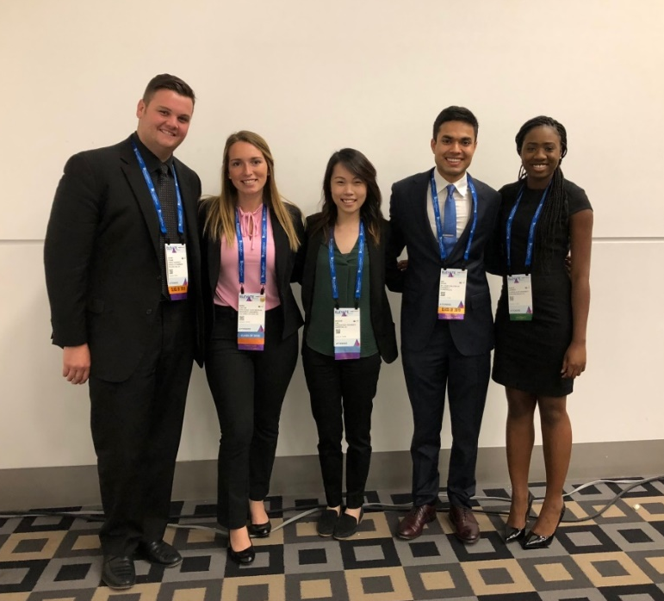
Volunteer Your Time
Contribute your skills and knowledge to the profession
Participate in a National Advisory Group or the National Student Forum Executive Committee
Find a volunteer opportunity that fits your interests and busy schedule

Slide 13
Present Your Research
Build your confidence and professional skills at ASHP’s Midyear Clinical Meeting, the largest meeting of pharmacists in the world
Share your research during the poster sessions and receive personalized feedback as part of ASHP’s Poster Mentor Program

Slide 14

Advocate for Your Profession
Build your advocacy skills
Stay updated on the latest legislative issues
Advocate through ASHP, your state affiliate and your SSHP
Familiarize yourself with how to advance practice at the state and federal level
Participate in policy development through the ASHP House of Delegates process

Slide 15

Support Your Well-Being
Visit the ASHP Well-Being & You site
Take the Well-being Pledge
Learn how other student pharmacists practice self-care and build resilience
Plug into #WellBeingWednesdays
Share your success stories on Well-Being and Resilience

Slide 16
The Value of ASHP Membership
For less than $5 per month, you can enjoy these
VALUABLE MEMBERSHIP BENEFITS
  Residency Resources
  CV Review Program
  Mentor Match
  AJHP® and AJHP Residents Edition ($530 value)
  AHFS® Clinical Drug InformationTM ($204 value)
  ASHP Midyear Clinical Meeting & Exhibition ($140 savings)
  And more!

Slide 17
SSHP Membership
[Insert membership fees]
[Insert registration information]
Member Benefits
[Insert SSHP member benefits]

Slide 18
SSHP Leadership Opportunities
[Insert SSHP Leadership Opportunities]
Deadline
Responsibilities
Number of positions available

Slide 19
Upcoming SSHP Events
Fall and Winter
[Insert events]

Slide 20
Upcoming SSHP Events
Spring
[Insert events]

Slide 21






Stay Connected with ASHP!
Twitter
@ASHPOfficial
LinkedIn
linkedin.com/company/ashp
YouTube
@ASHPOfficial
Facebook
facebook.com/ASHPOfficial
Instagram
@ASHPOfficial
ASHP Connect

Slide 22



Next Steps
Join
  ASHP National
  State Affiliate
  SSHP Student Society
Advance your career with ASHP’s professional resources
Get involved
  National Leadership Opportunities
  National Meetings
Visit ashp.org/studentmembership for more information
Questions? Email students@ashp.org

