Slide 1
ASHP ACCREDITATION SERVICES
Accreditation Report Response
Post-Survey:
Program Report Response Guidance
Revised October 2024

Slide 2
ASHP Accreditation Report Response Guidance
Objectives of Report Response Guidance Tool
Explain post-accreditation survey timeline
Describe program report response requirements
Direct programs to additional report response resources
Explain common report response pit-falls

Slide 3
Post-Accreditation Survey Timeline
End of Survey:
Verbal Exit Report by Survey Team
Pre-Commission on Credentialing Mtg:
Survey Team reviews report response and provides recommendation to COC
~30 Days Post-Survey: Formal written report sent to site by ASO
COC Mtg:
COC reviews program’s report response and survey team’s recommendation and votes on accreditation/reaccreditation
75 Days Post-Survey:
Report response from site due to ASO
Post-COC Mtg:
ASHP BOD reviews and votes to approve the COC voted actions on (re-) accreditation status; ASO notifies program
ASO = Accreditation Services Office
COC = Commission on Credentialing

Slide 4

COC Mtg & Report Response Review Schedule
Early March
  Reviews initial and reaccreditation survey report responses for surveys conducted between second week of May and November 30th of the year prior
  Reviews progress report/special case report responses for reaccreditation
Early August
  Reviews initial and reaccreditation survey report responses for surveys conducted between December 1st and first week of May
  Reviews progress report/special case report responses for reaccreditation
November/December—For reaccreditation limited circumstances only
  Report due around November 1st

Slide 5
Accreditation Survey Key Points:
(Re-)Accreditation surveys are quality improvement opportunities for residency programs.
Every residency program will have areas of findings on their (re-)accreditation report.
The exit report delivered at the end of the (re-)accreditation survey is not the ultimate determining factor in (re-)accreditation.

Slide 6
Accreditation Survey Key Points:
The program’s report response submitted 75 days post-survey is used to determine (re-) accreditation status and duration of (re-) accreditation status.
The 75-day report response time provides programs with opportunities to address all findings.
The strength of the program’s report response is key in the (re-)accreditation decision.

Slide 7
Survey Exit Report
The survey team provides a detailed verbal exit report of areas of partial compliance and non-compliance on the final day of survey which the program will need to address in the report response
Opportunity for the program to ask questions/seek clarification of any areas of findings
Programs should take notes during exit report (consider using pre-survey self-assessment template) and ask questions to ensure understanding of findings
Survey team members are available for further questions and clarification post-survey during the 75-day report response timeframe

Slide 8
Written Survey Report
The accreditation services office (ASO) will email the formal written report to the program’s RPD within approximately 30 days of end of survey
If the RPD does not receive the final written report from ASO within ~35 days, the RPD should contact the Lead Surveyor
Once the RPD receives the written report from ASO, the site has 45 days to complete the report response (total report response time ~75 days)
Written report contains all areas of findings (partial and non-compliance) that should match the findings shared during the survey exit report sessions

Slide 9
Review of Ratings Scale
Non-Compliance (NC)
No (or insufficient) evidence observed by/provided to survey team to demonstrate that the Standard has been implemented within the program and/or practice site(s)
Partial Compliance (PC)
Evidence observed by/provided to survey team to demonstrate that the Standard has been partially implemented (range of 1-99%) within the program and/or practice site(s)
Full Compliance (FC)
Evidence observed by/provided to survey team to demonstrate that the Standard has been fully implemented (100%) within the program and/or practice site(s)

Slide 10

Program Report Response Components:
Statement of each area of partial compliance and non-compliance from written report (re-state each area of PC & NC in the same order as in the written report from Accreditation Services Office)
Narrative by the program—Describe actions taken to resolve the finding (or actions taken to make progress in resolving the finding)
Timeline—For items that are not fully resolved in 75-day report response timeframe, describe timeline and anticipated milestones for resolution to meet full compliance
Evidence—Items that demonstrate implementation of action plan and resolution of finding to reach full compliance

Slide 11
Key to Report Response:
Address each area of partial and non-compliance with a succinct but complete narrative on what has been done to resolve or make progress on each element of the finding
For areas that are not fully resolved during response timeframe, must include a detailed timeline of dates and steps planned to fully resolve finding in a reasonable timeframe
Regardless of ability to fully resolve during report response timeframe, must include evidence for each area of finding to demonstrate resolution or progress in resolving the finding to reach full compliance
Verbal consultative recommendations that may have been provided during survey have no impact on (re-)accreditation decisions

Slide 12
NOTE: Do NOT copy/paste sections from evidence into the narrative

Slide 13
Pay close attention to findings that are in Standards which are Critical Factors—these are weighted more heavily in (re-) accreditation decisions

Slide 14
Submission of Completed Report Response
Include cover letter (transmittal letter) with report response
  Must be signed by the RPD, Pharmacy Director/College of Pharmacy Dean, and CEO/Designated Executive Leader of Sponsoring Organization
Report response must be submitted in PDF format
All appendices must be bookmarked in a single PDF packet

Slide 15
Program Narrative in Report Response
Include detail on what has been done to resolve (or make progress) on each element of the Standard
  Address any changes made
  Address when changes implemented
  If unable to fully resolve, address what changes have been made during report response and what the plan is for future changes to be implemented to fully resolve the finding
Avoid restating items that had already been implemented prior to survey and/or that were already observed/discussed at time of survey
If unable to fully resolve finding during report response timeframe, include a detailed timeline of anticipating milestones (with dates) for fully resolving finding (reaching full compliance)
  Timeline should be “reasonable” relative to complexity and resources needed to resolve the finding
Narrative to Address the Finding

Slide 16
What NOT to Say in Report Response Narrative
“It is anticipated…” or “It is hoped…”
“If…., it may be possible to…”
“Will be the focus of discussion”
“Have attempted to address…”
“We encourage…”
“This has been completed” (without providing additional detail)
These phrases are all examples of vague or unsubstantiated responses and do not demonstrate concrete action taken by the program in addressing the finding

Slide 17
Words for “Success” in Report Response Narrative
“The plan is to…”
“We have revised…”
Then add specific detail about the plan (who, what, when, how, etc.)
Be specific about what has been revised (policy, procedure, protocol, learning experience description, etc.) and approval status if applicable
“The timeline for implementation is as follows…”
“We are addressing the issue by…”
Then add specific detail about who, when, and how, etc.
“We have implemented…”
“We have approved…”

Slide 18
Example of Program Report Response Template

Slide 19
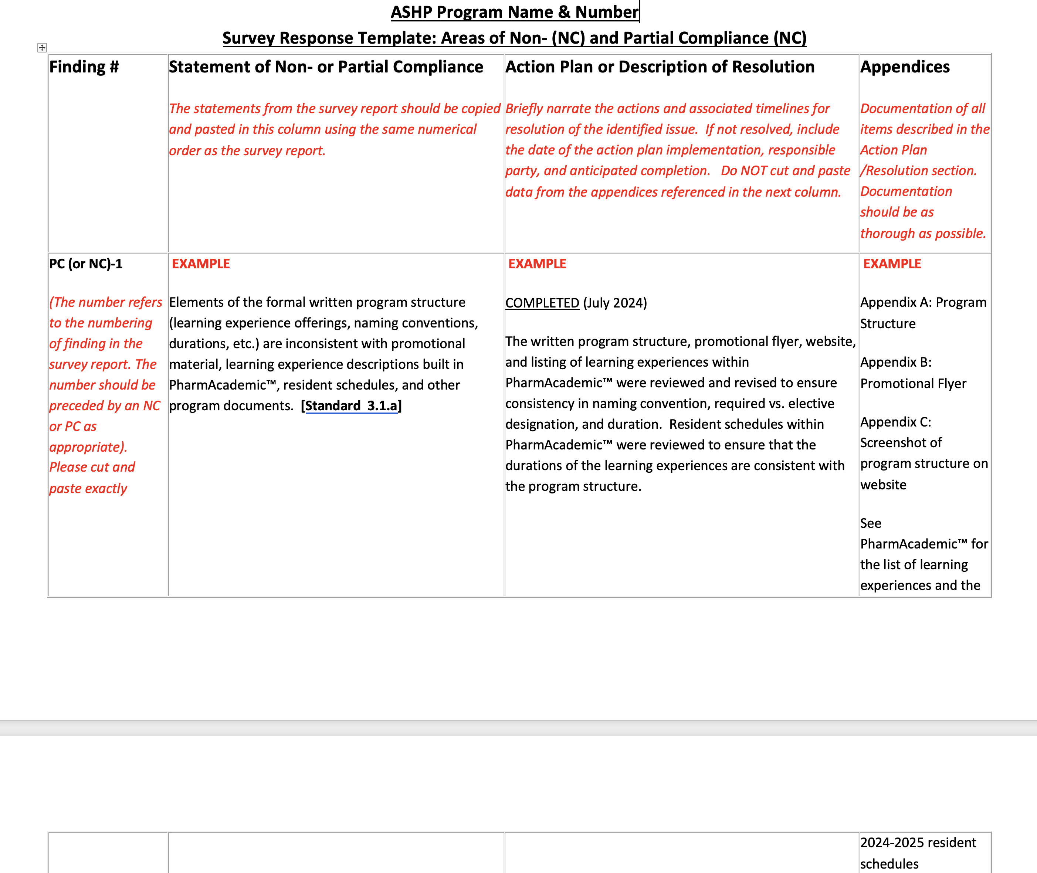

Slide 20
Examples of Report Response Narratives
(Hypothetical Survey occurring July 2024)

Slide 21
PC-8: Learning experience descriptions do not always outline the role of the pharmacist or the expected progression of the resident. Further, a learning experience description has not been developed for the required longitudinal teaching certificate program. [Standards 3.2.a, 3.2.a.2, and 3.2.a.4]
What to Say:
“A preceptor development session was held in August 2024 to review the Standards related to learning experience descriptions and share best practice examples of LEDs obtained from the ASHP website’s residency example documents. The preceptors reviewed and revised their LEDs. We then utilized the program’s residents (who had also attended the preceptor development session on LED requirements) to serve as peer reviewers for each LED. The RPD then reviewed each revised LED in PharmAcademic, confirming that all are completed at time of response submission. The preceptor for the longitudinal Education and Precepting learning experience revised the LED to include the required longitudinal teaching certificate component, ensuring that the program is included in the general description and in the expected progression and activities.”
What NOT to Say:
“We have fixed this”
OR
“We are planning on having the preceptors revise their LEDs prior to the next residency year. They understand and acknowledge that this is an expectation of all preceptors to review and keep their LEDs current with all required elements of the Standards”
OR
“We have reminded preceptors to review their LEDs to ensure that each contain all required elements and encouraged them to complete as soon as possible.”

Slide 22
PC-13: For learning experiences greater than 12 weeks, a summative evaluation is not always completed at evenly spaced intervals and by the end of the learning experience, with a maximum of 12 weeks between evaluations. [Standard 3.4.b.1.a]
What to Say:
“The RPD has reviewed this finding with all preceptors at the July 2024 RAC meeting and discussed strategies to improve evaluation timeliness. The RPD will meet with the residents to discuss a new process for having the residents now set-up calendar invites at the beginning of each learning experience for the discussion of summative and quarterly evaluations for mutually agreeable times within 3 days of the end of the learning experience or quarter with the preceptor(s). In August 2024, the RPD has also started reviewing the Overall Evaluation Status Report from PharmAcademic monthly to assess timeliness of evaluations, reporting out quarterly to the RAC the timeliness trends. If this initial plan does not fully resolve the finding by January 2025, the RPD will then begin sending out a follow-up email reminder to the primary preceptor and resident within 3 days of an overdue evaluation. Timeliness with evaluations has been added to preceptor reappointment review process and individualized preceptor development plans will be implemented if trends in overdue evaluations are noted.”
What NOT to Say:
“The RPD has discussed the expectations of timeliness with the preceptors and anticipates improvement on timeliness going forward.”
OR
“Preceptors have been encouraged to be more timely in their completion of summative and quarterly evaluations.”
OR
“We have been improving in our timeliness of evaluation submission over the last three years and expect this trend to continue.”

Slide 23
PC-28: A system to ensure and support continuity-of-care during patient care transitions for all patients in the medical center has not been fully optimized by the pharmacy department within the organization. Specifically, pharmacy personnel are not routinely involved in the medication history intake process and are not involved at all in the discharge medication review to support medication reconciliation at the medical center. [Standard 5.3.a.6]
What to Provide as Evidence:
“RPD and DOP met with local pharmacy school to discuss plan for ensuring an APPE student is assigned monthly to the site’s new TOC rotation beginning in August 2024 where part of the student’s responsibilities will include conducting medication histories. In the interim, our current resident has developed educational resources/how-to guides for the students on how to conduct med histories. Our current resident has also developed a process as part of their QI project to pilot a discharge medication list review and complete discharge medication education for patients at highest risk for readmission (CHF, COPD). The resident worked with IT to develop a daily report identifying such patients to complete the review. For the FY 2025 budget cycle, the DOP is requesting 2 Technician FTEs for the purpose of admission med history intake and 1 RPh FTE to add to the clinical pool to support the expansion of TOC activities so that each RPh will be able to review the discharge med lists for the patients on their units to support discharge med rec. The DOP has also met with the COO to discuss this request in September 2024. Anticipated implementation to reach 100% by October 2025.”
What NOT to Say:
“Prior to the accreditation survey, we had already started having pharmacy interns in the summer conduct medication histories and had requested 2 RPh FTEs last year to work in the ED to help with med rec but the COO denied the request. We hope to revisit this again in the next few years.”
OR
“The pharmacy department has been very short-staffed so we have not had the opportunity to pursue potential workflow changes or securing of resources to expand pharmacy services in this area. We anticipate working on this within the next one to two years.”

Slide 24
Examples of Report Response Evidence
(Hypothetical Survey occurring July 2024)

Slide 25
PC-28: A system to ensure and support continuity-of-care during patient care transitions for all patients in the medical center has not been fully optimized by the pharmacy department within the organization. Specifically, pharmacy personnel are not routinely involved in the medication history intake process and are not involved at all in the discharge medication review to support medication reconciliation at the medical center. [Standard 5.3.a.6]
What to Provide as Evidence:
“Appendix W—Meeting notes from meeting w/local pharmacy school
Appendix X--Educational resources/how-to guides for the students on how to conduct med histories
Appendix Y– Resident QI plan for discharge medication list review
Appendix Z—Deidentified daily report identifying high-risk patients for discharged medication list review
Appendix AA—FTE Proposal for FY 2025 budget cycle”
What NOT to Say:
“Appendix W—2023 Pharmacy Strategic Plan outlining TOC goals
Appendix X—EHR Instructions for completion of medication history intake (rev. 10/23)
Appendix Y—Dashboard of Pharmacy medication history intake encounters and interventions, 2023
Rationale for why this is not a good example—the above items are items 2023 (pre-survey) and would have been in place and observed at time of July 2024 survey, therefore do not reflect any changes or progress made since the survey

Slide 26
PC-13: The program structure does not ensure that all completion requirements outlined in the program’s Competency Areas, Goals, and Objectives are completed. Specifically, there is no evidence that residents have completed formal written reports of their longitudinal research project. [Standard 3.1.b.1]
What to Provide as Evidence:
“Appendix F—Completion Requirements Checklist
See revised Project LED in PharmAcademic™ with the manuscript added as an activity to objective R2.1.6 and the “Manuscript” deliverable in PharmAcademic™ for John Doe (under resident’s Files tab)”
What NOT to Say:
“This has been addressed. See attached”
Rationale for why this is not a good example—no direction is provided to the Lead Surveyor that the Project LED has been revised in PharmAcademic™ nor that the manuscript deliverable is within PharmAcademic™ nor where to find the completed deliverable in PharmAcademic™ to illustrate adequate progress

Slide 27
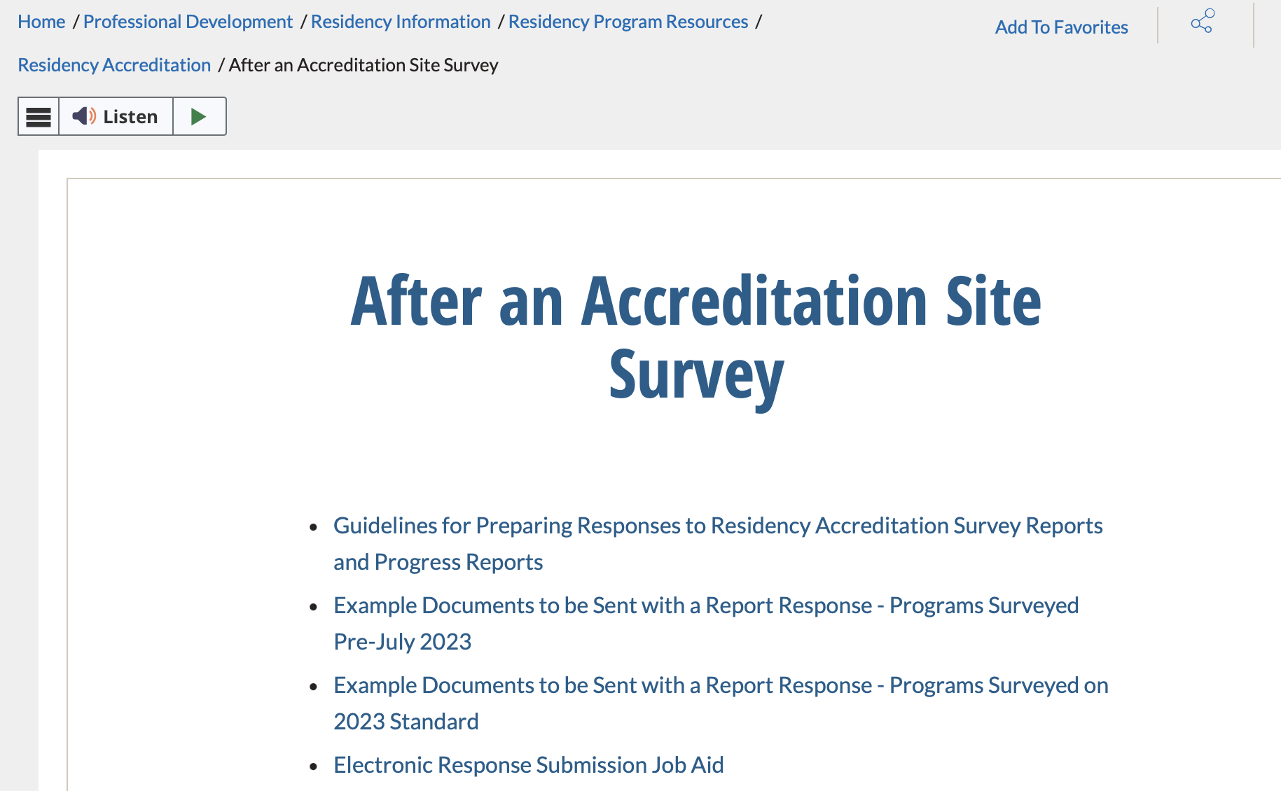
ASHP Toolkit Available
Proceed to the ASHP Residency Program Resources page for example report response template and examples of evidence to submit for any Standard that is cited in the survey report
Resource Alert!
Pathway: ASHP Homepage → Professional Development → Residency Information → Residency Program Resources → Residency Accreditation → After an Accreditation Site Survey

Slide 28

Keys to Report Response Success
Resolve the simple issues immediately (e.g., policy revisions, incomplete resident schedules, inconsistencies in written program structure and promotional material, revisions to LEDs in PharmAcademic, missing or incomplete APRs and preceptor development plans, resident development plans, etc.)
Assign a specific individual to be responsible for addressing the finding
Address the areas of partial and non-compliance—do not talk around the issues or make excuses
Provide a specific action plan
Provide a specific timeline
Provide actual examples that demonstrate implementation of the action plan/resolution of the issue (or at minimum examples that demonstrate progress in the implementation of the action plan)
Provide statistics/data if appropriate to the finding

Slide 29
How does the COC make accreditation decisions?
Multiple COC members review the program’s report response as well as the survey team’s assessment of the program’s report response.
COC members discuss all programs due for initial or re-accreditation review at the COC meeting.
Lead Surveyors are available to address questions of the COC members about the program, site survey, and clarify additional detail from the report response review.
COC members vote on the initial or re-accreditation status and duration of (re-) accreditation of each program reviewed at the COC meeting.
  Voting options for full initial and re-accreditation surveys:
    Not accredit a program being reviewed for initial accreditation
    Accredit a program being reviewed for initial or re-accreditation
      8 years (Full-cycle)
      4 years
      1 year
      Conditional/6mths (Re-accreditation only)
      Other durations (2 years, 3 years, 7 years)—For progress reports only
Commission on Credentialing

Slide 30
After the COC Meeting
Decisions from the COC proceed to the ASHP Board of Directors to vote to approve the month following the COC Mtg (i.e., April, September, January)
Accreditation Services Office emails the program the voted action letter notifying the program of:
  The COC decision of initial/re-accreditation
  The COC decision of duration of accreditation if accredited
  Outlines the Standards that were determined by the COC to be fully resolved (i.e., changed to “Full Compliance” based on report response)
If duration conferred is less than full-cycle (8yrs), a progress report will be required to be completed by the program for re-accreditation review by COC (same format and process as full survey report response), responding only to the areas that were not marked as “resolved” in the voted action letter
Commission on Credentialing

Slide 31
What to do if you do not agree with a component of the Standards
Comments and suggestions for the next version of the Standards should be sent to ASD@ashp.org with “Comments on the Standards” in the subject line of the email
Note that the Survey Team’s responsibility is to survey the program against the current Standards and that the Survey Team does not have the authority to change the Standards or bypass the full process for Standards revision—only the Commission on Credentialing has the ability to revise the Standards with subsequent approval by the ASHP Board of Directors
The Standards are revised approximately every 6-8 years

