Slide 1
Pharmacy Technician Education and Training Program Toolkit for Hospital and Health System Leaders
Prepared by the ASHP/ACPE Pharmacy Technician Accreditation Commission (PTAC)

Slide 2
Toolkit
Purpose
Assist pharmacy leaders in technician education and training program justification, development, and ultimately achieving ASHP/ACPE program accreditation
Provide pharmacy leaders with resources regarding career advancement and career ladders. As more motivated technicians remain at the institution, career advancement opportunities provide incentive and increase retention
Notes:
The purpose of this tool kit is to assist pharmacy administrators in justifying and developing a pharmacy technician education and training program, and ultimately apply for ASHP/ACPE accreditation. It has been found that pharmacy technicians that complete ASHP/ACPE accredited programs are more likely to not leave their site of employment, have higher job satisfaction, have higher pass rates on national certification exams, and are better prepared in providing a safe environment for medication preparation. In addition, offering a program provides an opportunity for other staff within a hospital or health system to seek another profession and the pharmacy department can recruit within their organization.
The other purpose of the tool kit is to provide the user with resources regarding career advancement and career ladders. As more motivated pharmacy technicians stay at the institution, the incentive is there for them with career advancement opportunities.
There are a variety of references provided regarding others that have been successful with their programs within the tool kit, as well as a wealth of information on ASHP/ACPE pharmacy technician education and training program accreditation on the ASHP website. There is a directory of all of the accredited and candidate programs available on the website to see over 250 accredited and candidate status programs, including over 30 programs in health systems. Please feel free to contact a representative in the Accreditation Services Office at asd@ashp.org with any questions as you embark upon this journey.

Slide 3
Toolkit Content: Part 1
Developing a Pharmacy Technician Training and Education Program
Planning tools and guidance for performing business analyses
  SWOT Analysis
  PESTLE Analysis
Human and Capital Resource Tools
Program Director - Job Description
Capital Resources
Simulation Environment and Training Ideas
Funding Ideas
Model Curriculum for Pharmacy Technician Education and Training Programs
Education and Training Standards
Strategic Plan
Other Resources

Slide 4
Toolkit Content: Part 2
Building Career Ladders
Career Advancement Opportunities
Career Ladder/Lattice Information and Examples
Pharmacy Technician Compensation Information
Supporting Literature
Other Resources

Slide 5
Part 1
Developing a Pharmacy Technician
Training and Education Program

Slide 6
Benefits of Developing a Pharmacy Technician and Education Training Program
For Employers
  Graduate retention as technicians
  Institutional internal career growth
  Graduates trained to perform safe medication practices
For Graduates
  Obtain professional certification
  Expanded employment opportunities
  Higher pass rate on national exams
  Job satisfaction

Slide 7
Planning Tools
Business Analyses
SWOT Analysis
  Internal analysis
  Helps evaluate one's strategic position in a business venture
  Helps identify favorable and unfavorable factors
  Helps to challenge risky assumptions
PESTLE Analysis
  External analysis
  Helps assess the current business environment
  Identify external factors that may impact strategy
  Helps chart future growth/strategy
Notes:
The purpose of this tool kit is to assist pharmacy administrators in justifying and developing a pharmacy technician education and training program, and ultimately apply for ASHP/ACPE accreditation. It has been found that pharmacy technicians that complete ASHP/ACPE accredited programs are more likely to not leave their site of employment, have higher job satisfaction, have higher pass rates on national certification exams, and are better prepared in providing a safe environment for medication preparation. In addition, offering a program provides an opportunity for other staff within a hospital or health system to seek another profession and the pharmacy department can recruit within their organization.
The other purpose of the tool kit is to provide the user with resources regarding career advancement and career ladders. As more motivated pharmacy technicians stay at the institution, the incentive is there for them with career advancement opportunities.
There are a variety of references provided regarding others that have been successful with their programs within the tool kit, as well as a wealth of information on ASHP/ACPE pharmacy technician education and training program accreditation on the ASHP website. There is a directory of all of the accredited and candidate programs available on the website to see over 250 accredited and candidate status programs, including over 30 programs in health systems. Please feel free to contact a representative in the Accreditation Services Office at asd@ashp.org with any questions as you embark upon this journey.

Slide 8
SWOT Analysis: Internal Business Analysis
Strength – Anything you consider to be a positive attribute to your success
What you do well What makes you different from the competition What internal dynamics exist to make you successful Assets
Weakness - Anything that you believe can be improved
Things that you could benefit from but don’t have Things your competitors have that you don’t Limited internal resources Lack of brand identity
Opportunity - Anything you deem as a potential benefit to your goals
What you do well What makes you different from the competition What internal dynamics exist to make you successful Assets
Strength – Anything you consider to be a positive attribute to your success
What you do well What makes you different from the competition What internal dynamics exist to make you successful Assets

Slide 9
SWOT Analysis - Template
 | HELPFUL Positive to achieving the objective | HARMFUL Negative to achieving the objective
Internal | STRENGTHS | WEAKNESSES
External | OPPORTUNITIES | THREATS

Slide 10
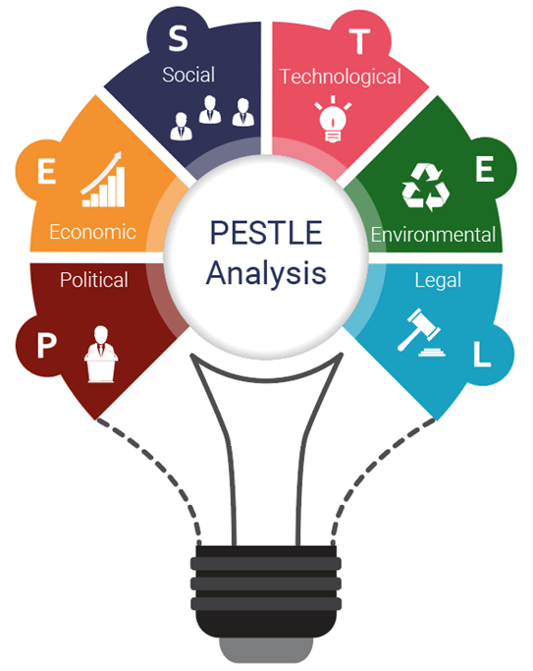
PESTEL Analysis – External Analysis
An attempt to understand context in which the organization exists by evaluating EXTERNAL forces that affect its present and future
Political
Economic
Social
Technological
Environmental
Legal

Slide 11

PESTEL Analysis - Template
P | E | S | T | E | L

Slide 12
Other Planning Tools
Create a timeline
  Create a reasonable timeline for implementation
  Include notification to ASHP of intent to accredit
Identify action items
  Prioritize based on importance and urgency
Create to-do-lists
  Organize by priority or due date

Slide 13


Human and Capital Resources
HUMAN RESOURCES
Create metrics for students to faculty ratios to promote an ideal learning experience (drive quality over quantity)
According to “The National Center for Education Statistics” the national average for top ranked post-graduate schools in the US is 14 to 1.
Smaller classes provide for more individual attention
Smaller classes allow for better simulation experience
Smaller classes allow for more time to properly assess and evaluate student progress
CAPITAL RESOURCES
Create a check-off list of essential and “nice to have” equipment to facilitate learning

Slide 14




Human Resources
Program Director/Coordinator
(Pharmacist or Technician)
Program Instructor(s)
(Pharmacist or Technician)
Program Preceptors
Pharmacists
Pharmacy Technicians
Program
Advisory Board
Pharmacy Staff
Program Graduates
Current Program Students
Academia (School of Pharmacy, local high school/technical or vocational schools)
Experiential Site Leadership and Professionals
Board of Pharmacy

Slide 15
Program Director
Organizational Title and Justification
Possible Job Titles
Director, Pharmacy Technician Education & Development
Coordinator, Pharmacy Technician Education
Manager, Pharmacy Technician Education and Development
Pharmacy Education Specialist
Additional Selling Points to Leadership
This role can be incorporated into other duties (ex. 0.8 FTE PD, 0.2 FTE Online/Workflow)
Educational oversight can be mitigated through use of third-party education tools/learning management systems (ex., PharmTech Ready, TRC)

Slide 16
Program Director
Sample Job Description
Pharmacy Technician Education and Training Program Director Job Description
The following criteria may be used for a standalone Pharmacy Technician Training Program Director position or alternatively can be incorporated into another role/position for someone that has more then one role in the pharmacy:
Organizational Relationships:
Works collaboratively with pharmacy leadership, staff, pharmacy students, and interdisciplinary departments.
Maintains collaborative relationships with both internal and external customers.
Position Overview (Major Functions and Non-Essential Functions):
Plans, implements and coordinates the Pharmacy Technician training program.
Provides a clearly communicated vision for sustainability and growth of the program.
Coordinates and develops onboarding and training for technician students; and instructor / preceptor development programs and activities.
Supports and participates in activities to improve and scale pharmacy education programs and processes.
Assists in the development and coordination of training and competencies for the institution.
Completes administrative reports and presentations in a timely and high-quality manner.
Ensures that the pharmacy technician training program meets all quality, legal, regulatory and accreditation standards.
Leads accreditation and reaccreditation processes, including survey preparation and finding follow-up.
Assists in the development and implementation of the goals and objectives of the program and associated strategic plan.

Slide 17
Program Director
Sample Job Description
Minimum Education and/or Experience Required (Minimum Job Requirements, Education Requirements, and Experience):
Licensed pharmacist or nationally certified pharmacy technician with at least five years of experience as a pharmacist or pharmacy technician in a pharmacy practice prior to entering the position
Demonstrated flexibility and creativity in educating various learning styles and developing teaching strategies.
Patience and ability to effectively coach and mentor others.
Strong commitment and evidence of achieving excellence.
Proven history of successfully working in a team environment, communicating effectively and working independently with minimal supervision.
Desirable Additional Experience and/or Qualifications (Has Achieved Competency in the Following Areas, Job Knowledge and Additional Considerations):
Project management, coordination, and presentation skills.
Prior experience in teaching, training, mentoring students/trainees/employees.
Computer competency including word processing, spreadsheet preparation, data collection/management/analysis, utilizing of learning management system technology, creation of graphs/charts and presentation slides.
The following are preferred: Experience in developing education and/or training programs.
Licensure/Certification Required:
Must meet ASHP/ACPE pharmacy technician education and training program standards for a program director who is a pharmacist or pharmacy technician

Slide 18


Capital Resources
Example Simulation Supplies
Pill counter(s)/spatula(s) Nonsterile compounding supplies, such as ointment jars, bottles, dropper bottles, empty capsules Flasks, mortar and pestle, measuring beakers and graduated cylinders, stirring rods Sterile compounding supplies, such as intravenous bags, syringes, needles, vials Point of care supplies
Dedicated Learning Environments Needs and Opportunities
Student Didactic Learning
AV equipment
Simulation
Hybrid Virtual Learning Application
Externship
Simulation Equipment
Automated dispensing cabinet
Laminar flow hood
Vertical flow hood
Bio-Safety cabinet
Powder hood
Scale(s)
Cash register or box
Vital sign and point of care equipment

Slide 19
Capital Resources
Computer Hardware/Software
Program supplied Laptops or students owned
Prescription processing software
Printers for prescription labels and patient paperwork
Other
Process for Basic Life Support training
Ability to perform background checks on prospective students
Ability to perform math and reading proficiency for prospective students
Process for Safety Data Sheet access

Slide 20

Training Standards
ASHP/ACPE Pharmacy Technician Education and Training Standards
Protect the public
Serve as a guide for pharmacy technician education and training program development
Provide criteria for the evaluation of new and established programs and,
Promote continuous improvement of established programs

Slide 21
Simulation Training
Can be completed in various locations/modalities:
Classroom and/or lab setting
In-Pharmacy training
  Completed on-site, using preceptors and/or designated trainers
    All activities must be completed without potential impact for patient harm and should not be live medications/preparations until after competency has been verified through instruction and training
    Can be completed “off-hours”, in designated areas/pharmacy satellites, and/or away from workflow involving patient care
    PRACTICE TIP: Many sites do simulation training in pharmacy satellites when closed

Slide 22
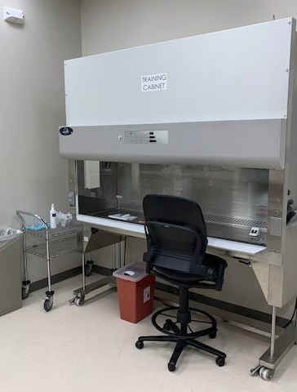
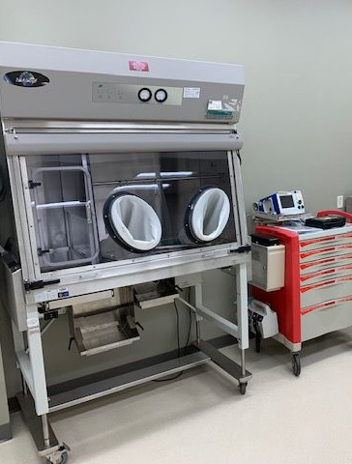
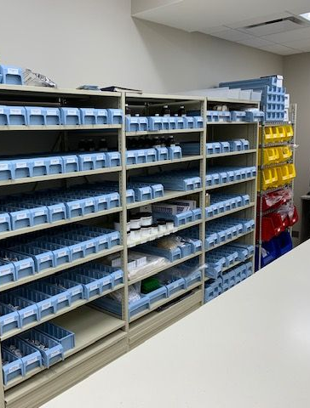
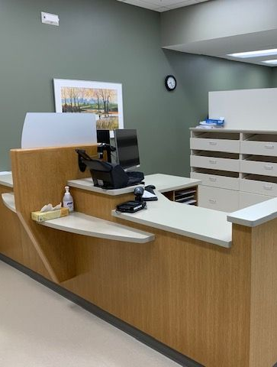
Best Practice Simulation Lab

Slide 23
Experiential Training
Professional, hands-on learning experience in your live pharmacy setting
Includes preceptor oversight
Conducted after simulation experience
Evaluation performed against standards

Slide 24

Funding Stream Opportunities
Certificate Programs - Tuition
US Department of Labor, Employment and Training Administration/Workforce Development Programs
  Provide access to training and education through Individual Training Accounts
    Tuition assistance offered for Occupational Training
    Offers connections to apprenticeship programs
Scholarships
Many employers will pay for their employees to obtain a certificate that is related to their employment. Consult the benefits section of the employee handbook.
Many professional organizations offer scholarships to incentivize people to join their profession. If one does not exist, connect with local pharmacy professional organizations.
Many hospital auxillaries offer scholarships to incentive people to join their organization.
Employment
Many organizations opt to hire candidates and require them to matriculate into the program as a condition of employment

Slide 25

Strategic Plan
What is it?
It represents a vision to drive organizational direction, change and transformation over time – a journey
It identifies where you are now and where you want to be – a vision
It enhances an organization's ability to adapt to change – organization resilience
It creates cooperation – teamwork
It directs daily activities towards a common goal - collaboration

Slide 26

ASHP/ACPE Video Developing a Strategic Plan for your Pharmacy Technician Program
PLAY VIDEO

Slide 27
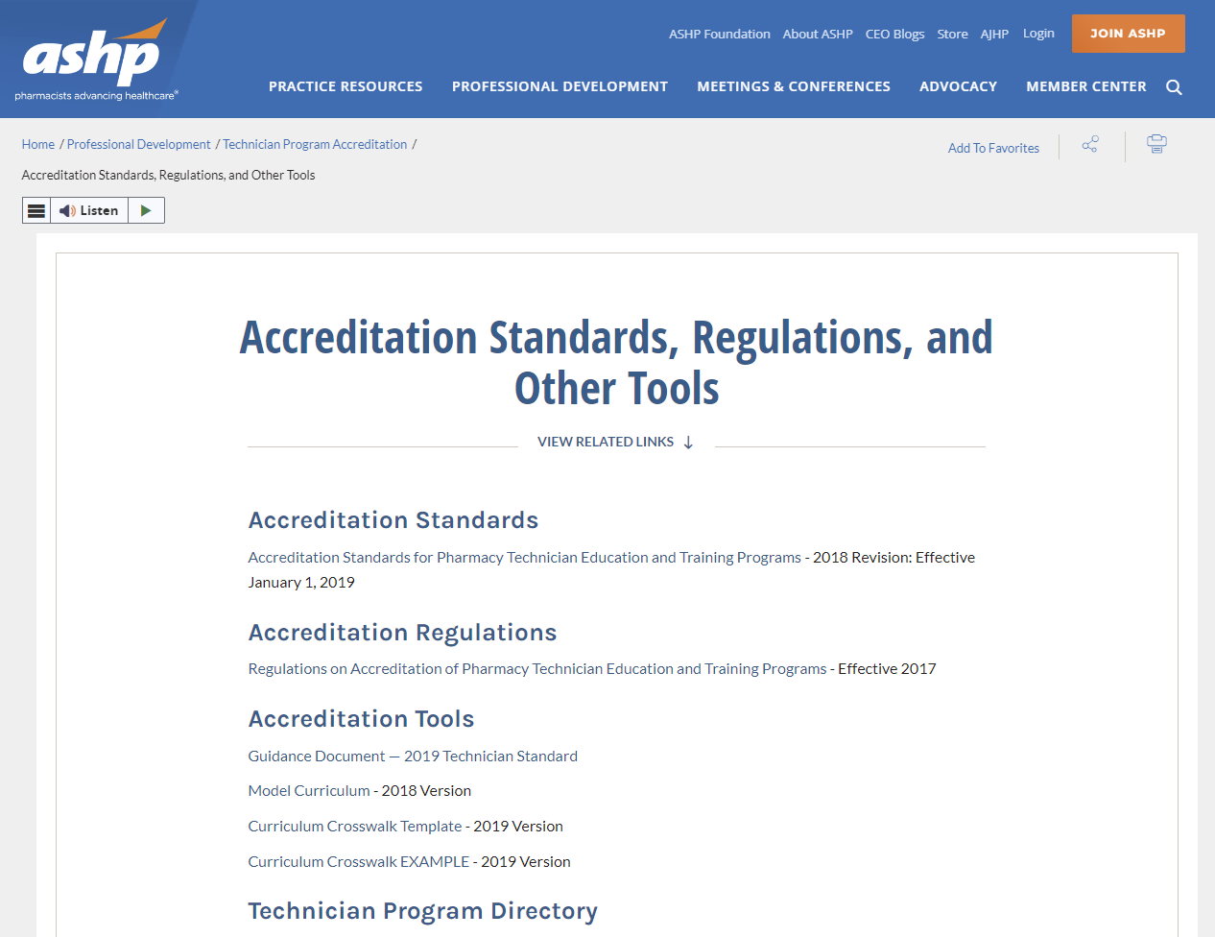
Resources from ASHP
ASHP website
Standards
Regulations
Guidance Document
Model Curriculum and Crosswalk
Technician Program Directory
Informational Videos
Contact asd@ashp.org

Slide 28


Standards
SCAN THE QR CODE

Slide 29
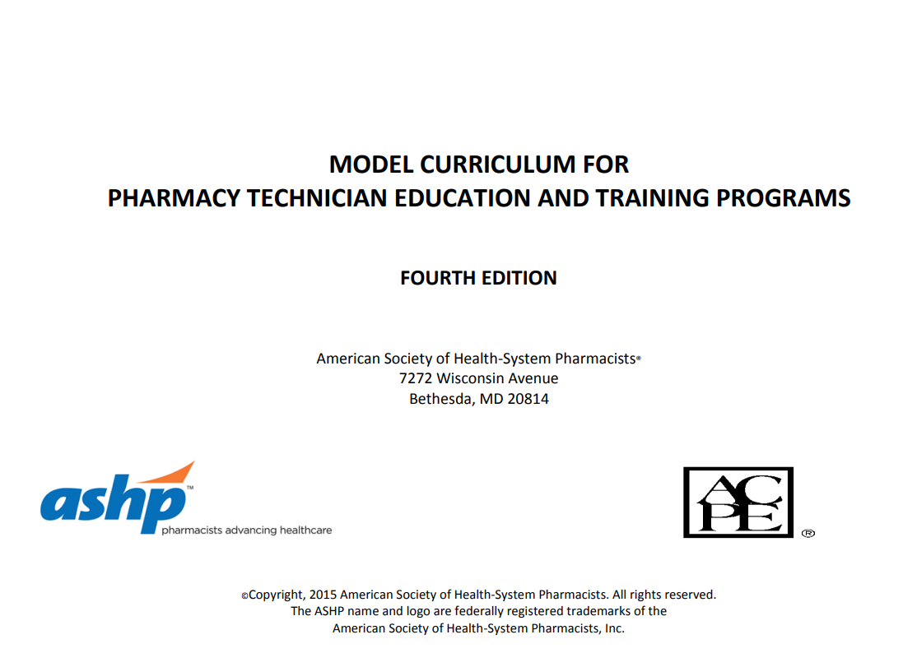

Model Curriculum
SCAN THE QR CODE

Slide 30
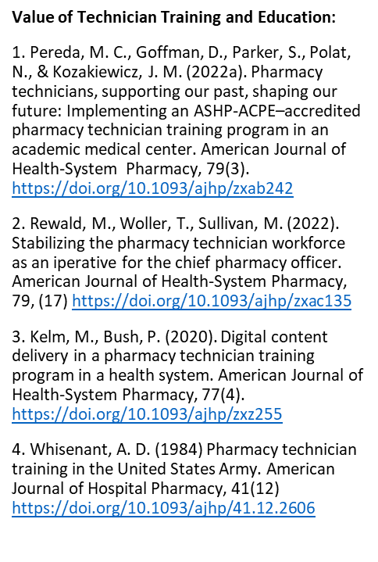
Supporting Literature for Value of Technician Training and Education
5. Thames, L., Johnston, C., Cash, j., Holder, M., Voils, A., (2024).Implementation of a Pharmacy technician career ladder and pharmacy technician training program. American Journal of Health System Pharmacy, 80(23) Https://doi/10.1093/ajhp/zxae603/7635178

Slide 31
Part 2
Building Technician Career Ladders

Slide 32

Career Advancement Opportunities
Promote Enhanced Program Director Status Within the Organization
Enhanced title
Advanced education
Provide Model Advancement Opportunities for Graduates
Career Ladder or Career Lattice
Advanced supervisor training/ certificate

Slide 33
Program Director
Current Practice
Current standards refer to a program director whose title within the organization may or may not be a director
Education and background requires graduation from an accredited training program or an AS or BS in any area of study
Practice Opportunity
Push for a Director title at the organization level to promote the importance of the position and academic achievement
Education and background require BS and certified teaching certificate in addition to CPhT status.

Slide 34
Career Advancement Methods
Career Ladder
Career Lattice
Utilizes vertical steps for advancement
Progression based on hard work, diligence, and dedication and thereby exceeding expectations
Enables the ability to progress in current position
Improves employee retention and morale
Utilizes vertical and horizontal steps for advancement
Progression based on learning something new or acquiring advanced certifications
Enables the ability to learn new skills in areas outside current scope
Improves employee retention and morale

Slide 35
Pharmacy Technician Career Ladder/Lattice
Provides incentives to improve skills and take on additional responsibilities
Pay/level increases are commensurate with advancing through each step
Provides job satisfaction though role expansion and specialization
Provides pharmacists ability to expand clinical roles
Graduates of an accredited pharmacy technician training program enter the career ladder at a higher level and
pay grade.

Slide 36
Pharmacy Technician Career Ladder - Example
Pharmacy Tech – non-certified – entry level
Pharmacy Tech I – entry level; must be nationally certified within a year OR be enrolled in or completed an ASHP/ACPE accredited tech training program.
Pharmacy Tech II – 2+ years experience preferred and nationally certified
Pharmacy Tech III – 5+ years experience preferred, nationally certified, displays attributes of informal leader and trained in most areas of the pharmacy, graduate of a nationally accredited pharmacy technician education and training program

Slide 37





Pharmacy Technician Career Lattice Options Horizontal Steps
Tier 1 High school graduate Limited/no experience | Tier 2 Certified Pharmacy Technician | Tier 3 Tier 2 requirements + 1 advanced practice, education, or research requirement | Tier 4 Tier 3 requirements + additional lattice requirement(s) | Tier 5 Tier 4 requirements + advanced credential, training, recognition
No Tier requirements No related experience State licensure/registration (if applicable) | Tier 1 requirements + national certification (PTCB or NHA) | One Advanced Certificate (PTCB or ASHP) OR Critical Point Certificate | Any three practice certificates OR one Critical Point certificate: Sterile Compounding or Best Practices and Compliance with USP 795 for Nonsterile Compounding | Advanced Certified Pharmacy Technician (CPhT-Adv) | Practice
 |  | Instructor / Preceptor | Instructor / Preceptor AND Two Formal Presentations | Assistant Professor | Academia
 |  | CITI Good Clinical Practice Certificate | FunCaTS classes AND about 5.5 hours of other Internal research and auditing classes | ECaTS AND 24 hours - more hours of CITI courses AND about 13 hours of Internal classes | Research
 |  | Internal “Aspiring Leader Program” ~ virtual or self-paced | Individual Business Plan through Udemy with minimum of 12 CE hours | ASHP Pharmacy Leadership Academy | Leadership
Notes:
Tiers are self-paced. However, there is much encouragement to be certified by 12-18 months of hire.

Slide 38
Pharmacy Technician Career Lattice Options
Vertical Steps
Tier 3 | Tier 4 | Tier 5
One Advanced Certificate (PTCB or ASHP) OR Critical Point Certificate | Any three practice certificates OR one Critical Point certificate: Sterile Compounding or Best Practices and Compliance with USP 795 for Nonsterile Compounding | Advanced Certified Pharmacy Technician (CPhT-Adv)
Instructor / Preceptor | Instructor / Preceptor AND Two Formal Presentations | Assistant Professor
CITI Good Clinical Practice Certificate | FunCaTS classes AND about 5.5 hours of other Internal research and auditing classes | ECaTS AND 24 hours - more hours of CITI courses AND about 13 hours of Internal classes
Internal “Aspiring Leader Program”~ virtual or self-paced | Individual Business Plan through Udemy with minimum of 12 CE hours | ASHP Pharmacy Leadership Academy
Tier 3 | Tier 4 | Tier 5
One-year of experience OR Advanced-level ASHP/ACPE accredited program | Three years of experience OR Advanced-level ASHP/ACPE accredited program and two years' experience | Five years of experience OR Advanced-level ASHP/ACPE accredited program and four years' experience

Slide 39
Supervisor Training Certificate
Create advanced credential program to enable graduates to gain supervisory experience
  Additional hours of learning in the area of management and leadership
    How to lead and manage
    Managing diversity in the workforce
    Effective communication and decision making
    People management basics
    Leadership behaviors to overcome challenges
    Myers-Briggs Type Indicator Assessment

Slide 40

Pharmacy Technician Compensation
Assess compensation utilizing the US Department of Labor, Bureau of Labor Statistics for Healthcare Occupations
Evaluate best practices of other Pharmacy Technician Training Programs for compensation

Slide 41
US Department of Labor BLS- Healthcare Occupations

Slide 42
Supporting Literature for Pharmacy Technician Career Ladders
Thames, L., Johnston, C., Cash, j., Holder, M., Voils, A., (2024).Implementation of a Pharmacy technician career ladder and pharmacy technician training program. American Journal of Health System Pharmacy, 80(23) Https://doi/10.1093/ajhp/zxae603/7635178
Deyhim, N., Bhakta, S. B., Varkey, A. C., Metzen, D. L., Varkey, D., Martinez, R. J., & Garey, K. W. (2021). Systemization of a pharmacy technician career ladder in a multi-hospital system. Exploratory Research in Clinical and Social Pharmacy, 2. https://doi.org/10.1016/j.rcsop.2021.100036
Mattingly, A. N., Mills, R., Leber, M. B., & Pereda, M. C. (2020). Implementation of a pharmacy technician career ladder. American Journal of Health-System Pharmacy, 77(9). https://doi.org/10.1093/ajhp/zxaa037
Myers, C. E. (2011) Opportunities and challenges related to pharmacy technicians in supporting optimal pharmacy practice models in health systems. American Journal of Health-System Pharmacy, 68(12). https://doi.org/10.2146/ajhp110056
Strozyk, W. R., & Underwood, D. A. (1994). Development and benefits of a pharmacy technician career ladder. American Journal of Hospital Pharmacy,51(5). https://doi.org/10.1093/ajhp/51.5.666

Slide 43
Acknowledgements
ASHP/ACPE Pharmacy Technician Accreditation Commission (PTAC)
  Amisha Arya PharmD, BCSCP, CJCP
  Melissa Heigham, PharmD, BCOP, BCPPS, MHA
  Janet M Kozakiewicz PharmD, MS, FASHP
  Matthew Rewald BS, CPhT, DPLA
  Tate Trujillo, PharmD, BCPS, FCCM, FASHP, CPEL
American Society of Health-System Pharmacists
  Samuel Calabrese, BSPharm, MBA, FASHP, CPEL
  Matthew J. Kelm PharmD, MHA, FNCAP
  Lisa S. Lifshin, BSPharm

